Slide 1
Technical Training Project Presentation
July 2023

Slide 2
Loan Processing Application
Team 1: Ganesh Meruga, Amara Sai Sahith, Aakash Malviya, Nikita Kanwar Naruka & Siddhant Jaiswal

Slide 3

Contents
Introduction
Front-end
Back-end
Demo
Model Development

Slide 4

Introduction
Welcome to the Loan Processing Application! Our user-friendly platform aims to streamline the loan application process, providing a hassle-free experience for our users. Whether you're a new applicant or an existing user, our system ensures a secure and efficient way to manage your loan applications.

Slide 5
Objectives
Signing in a new user.
Logging in existing user.
Submitting a new application.
Viewing all submitted applications.
Viewing a specific application.

Slide 6
Front-end (Angular)

Slide 7
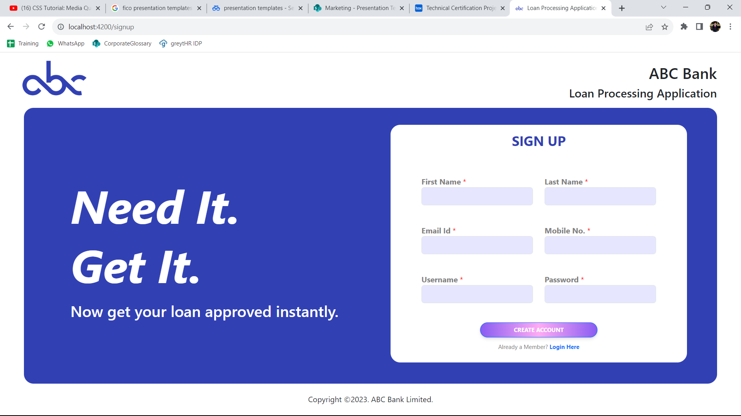
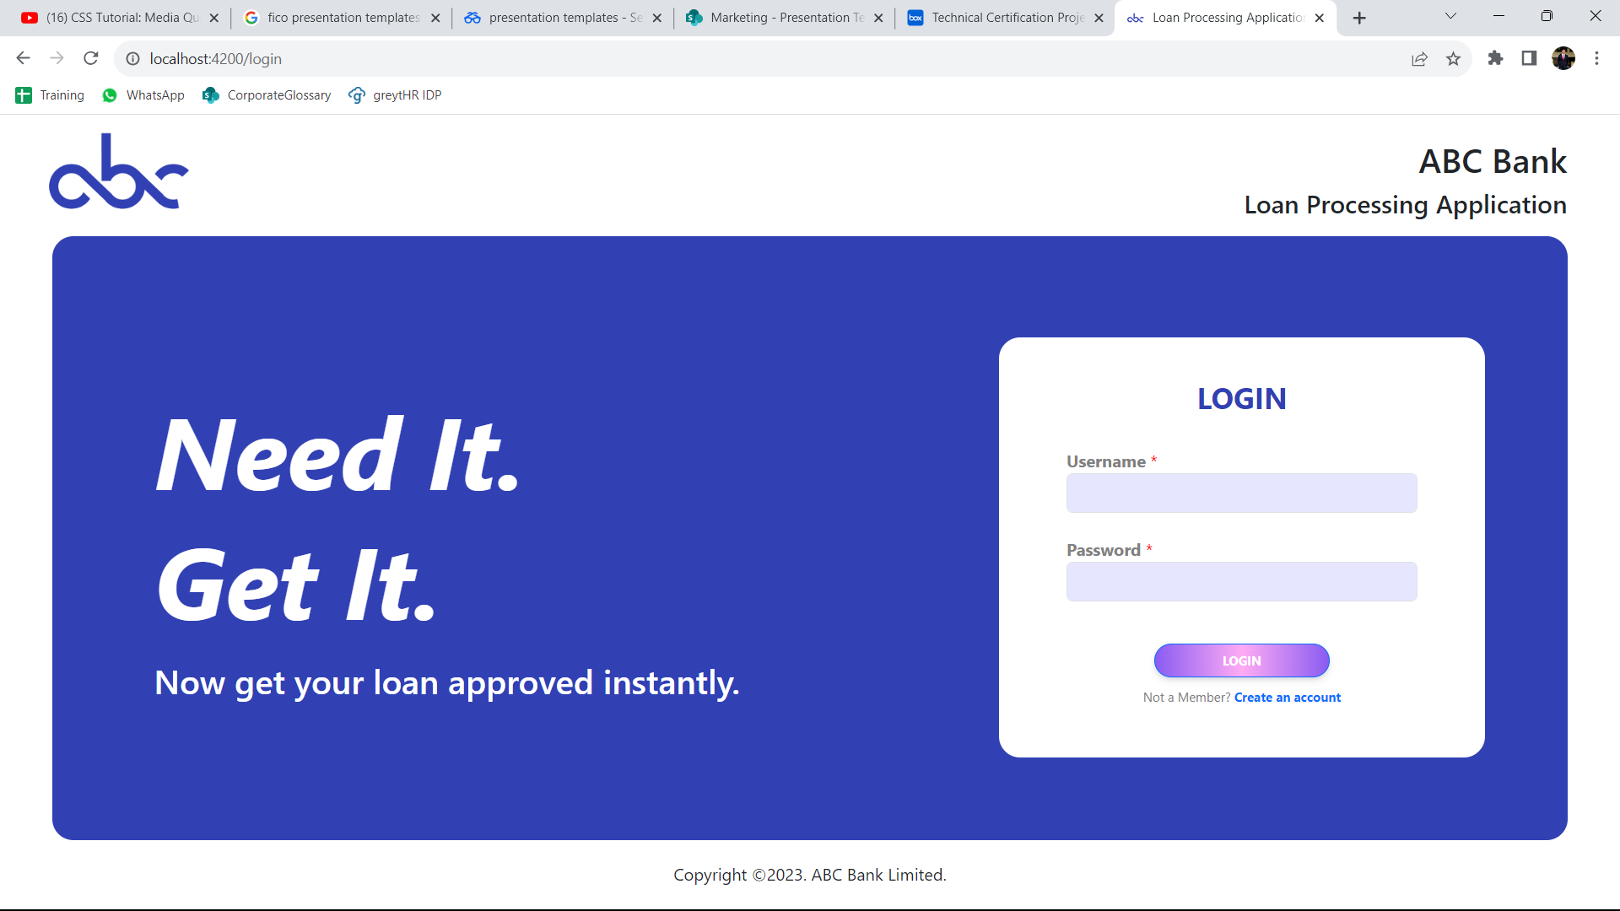
Sign Up and Login Components
HTML5: Structuring the components.
CSS3: Styling the components.
Typescript
Writing functionalities for signup and login.
Adding Validators and Form Controls to check for validations.
For signup and login button functionality

Slide 8
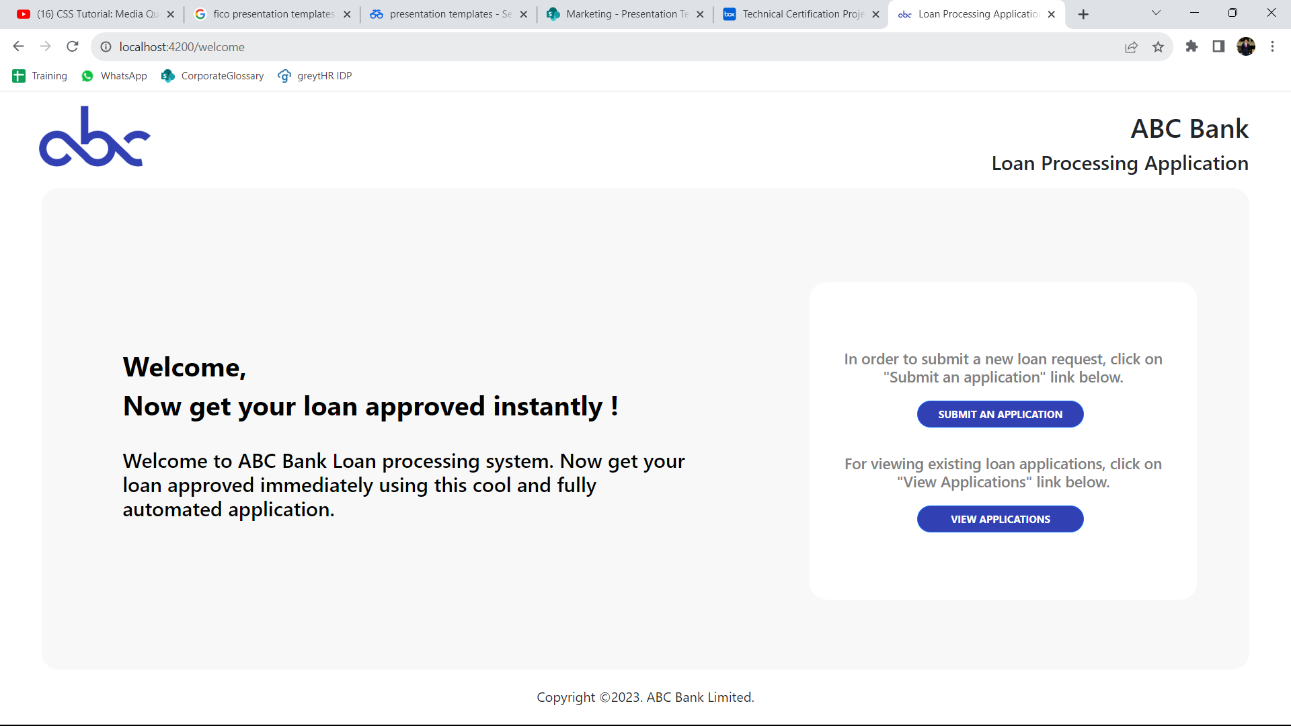
Welcome Components
Submit an Application
View applications.

Slide 9
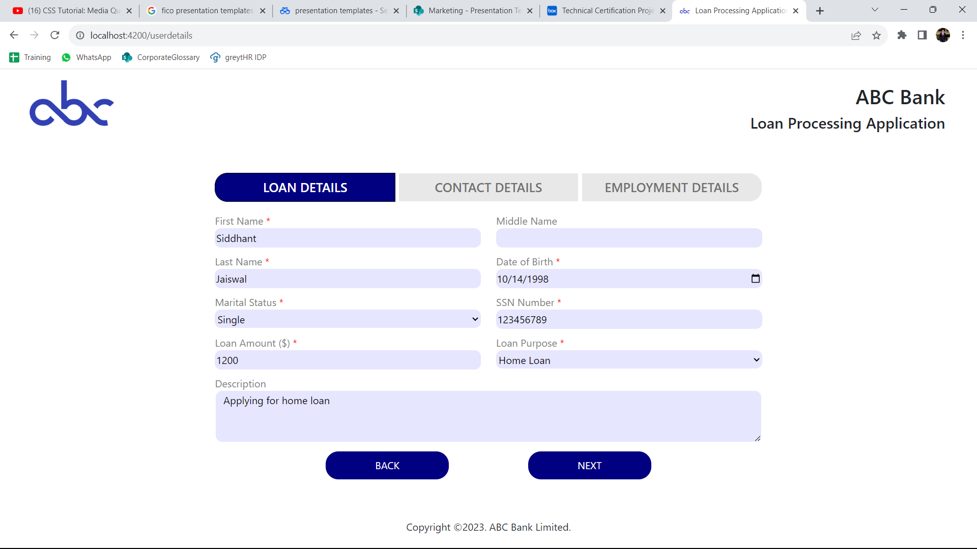
User Details Components
Loan Details

Slide 10
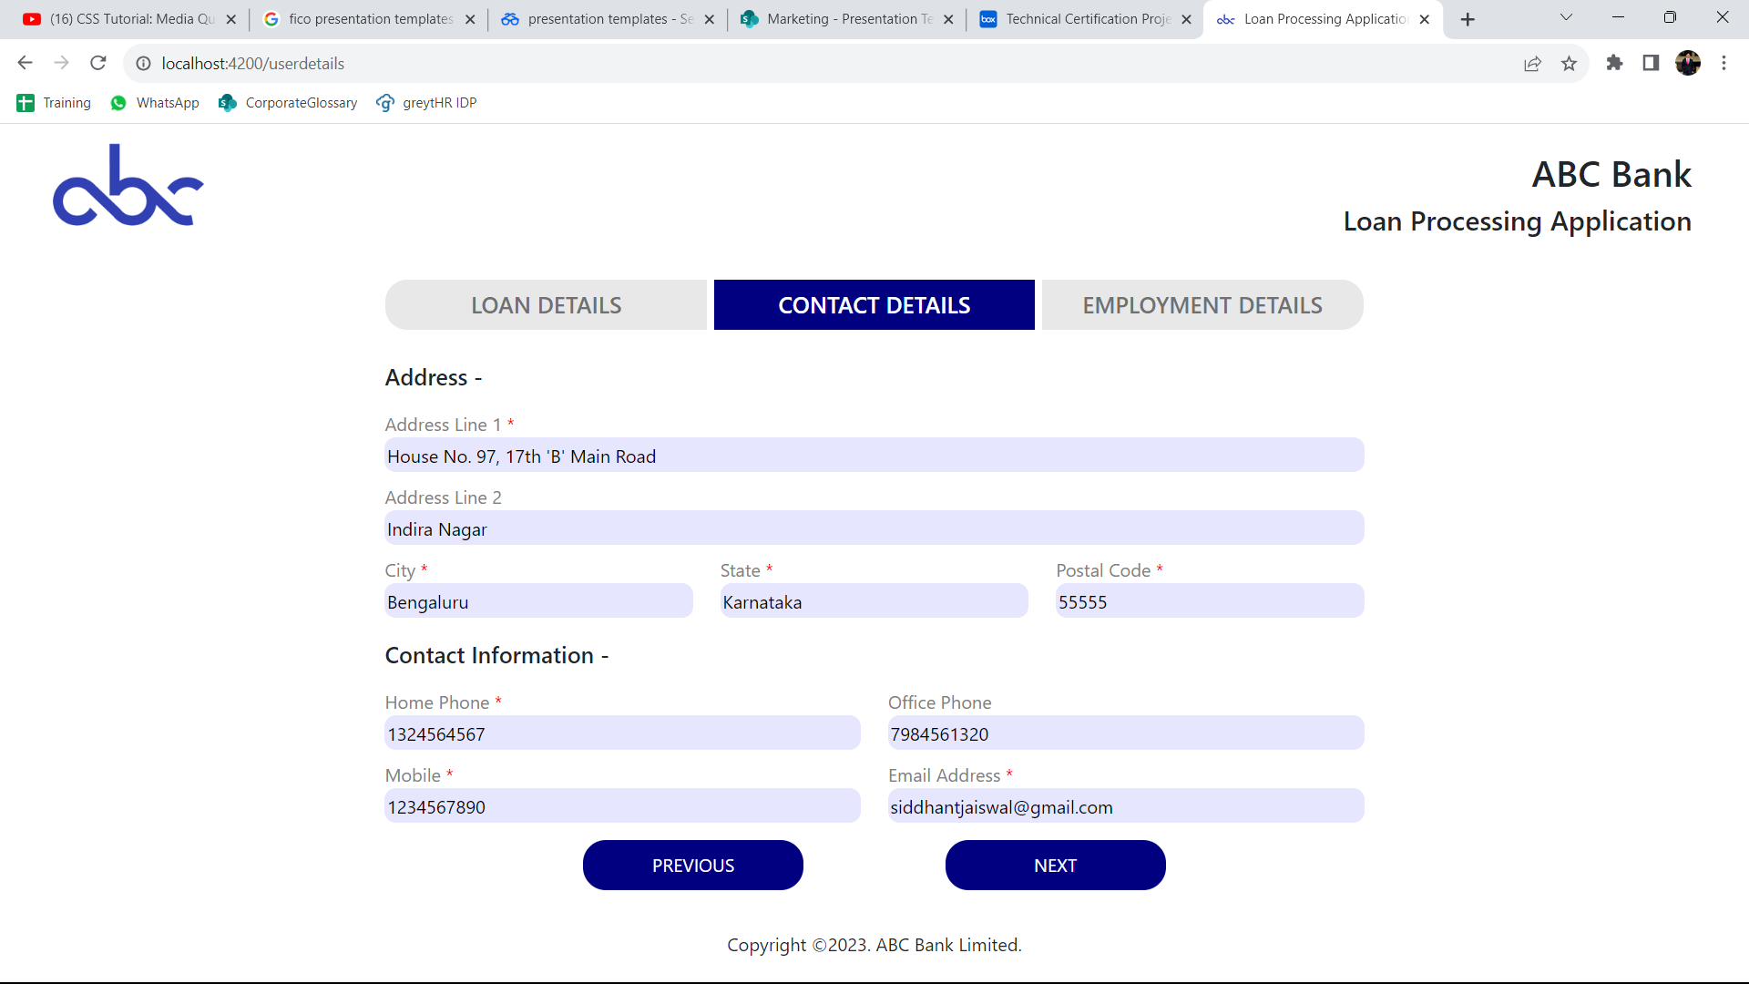
User Details Components
Contact Details

Slide 11
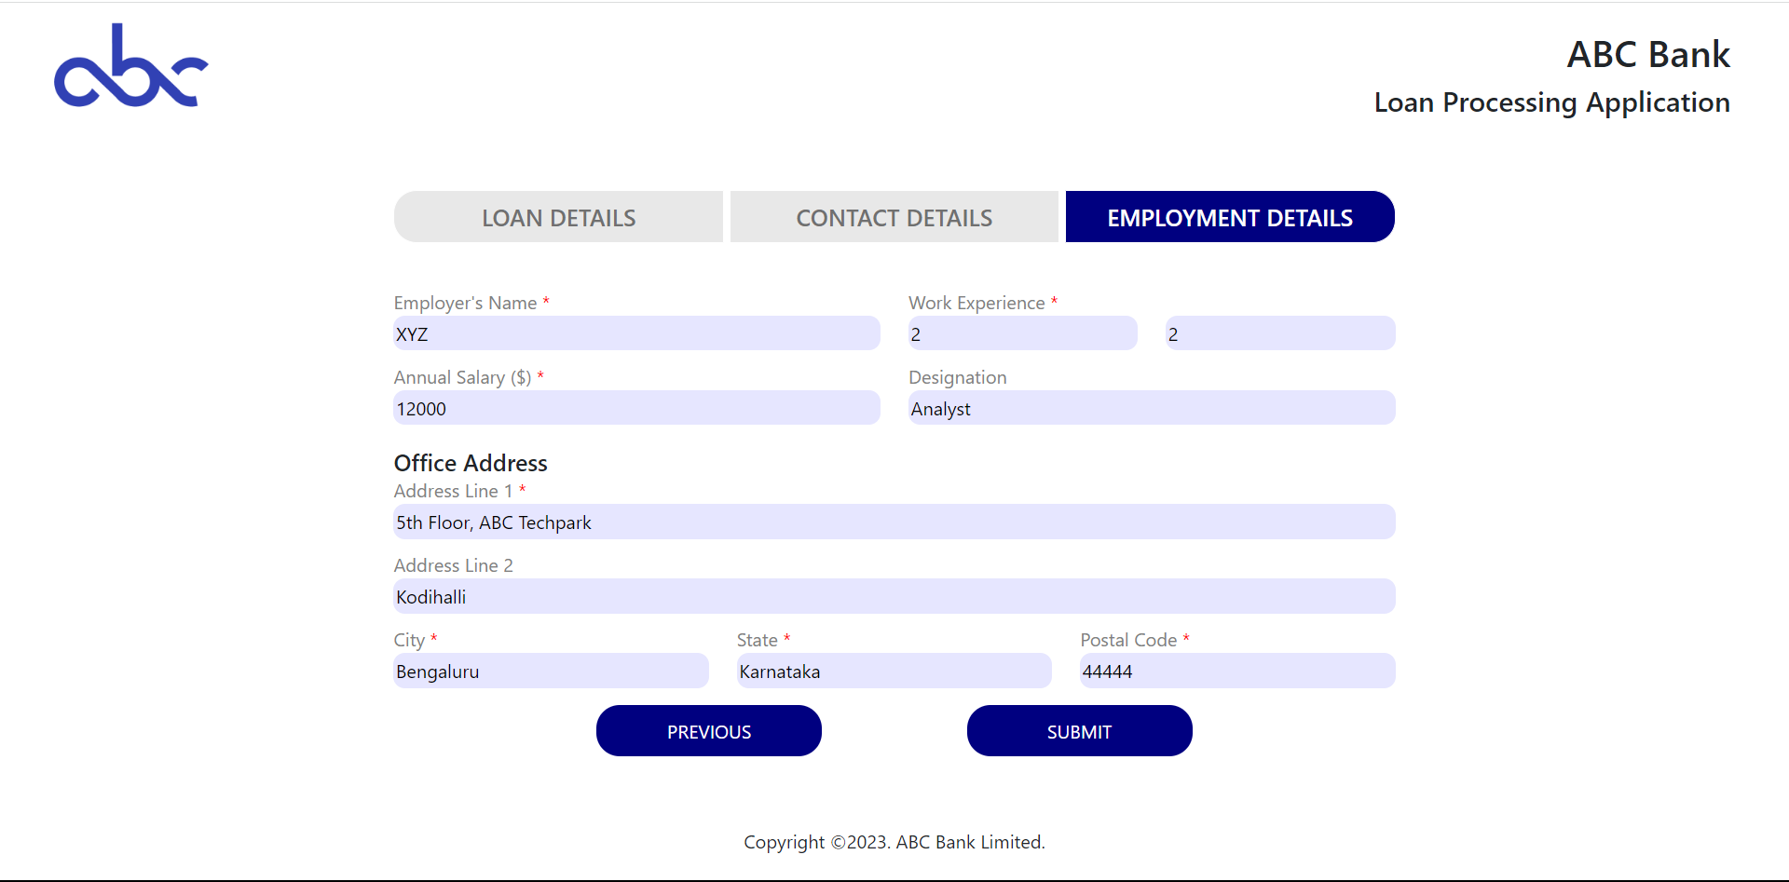
User Details Components
Employment Details

Slide 12
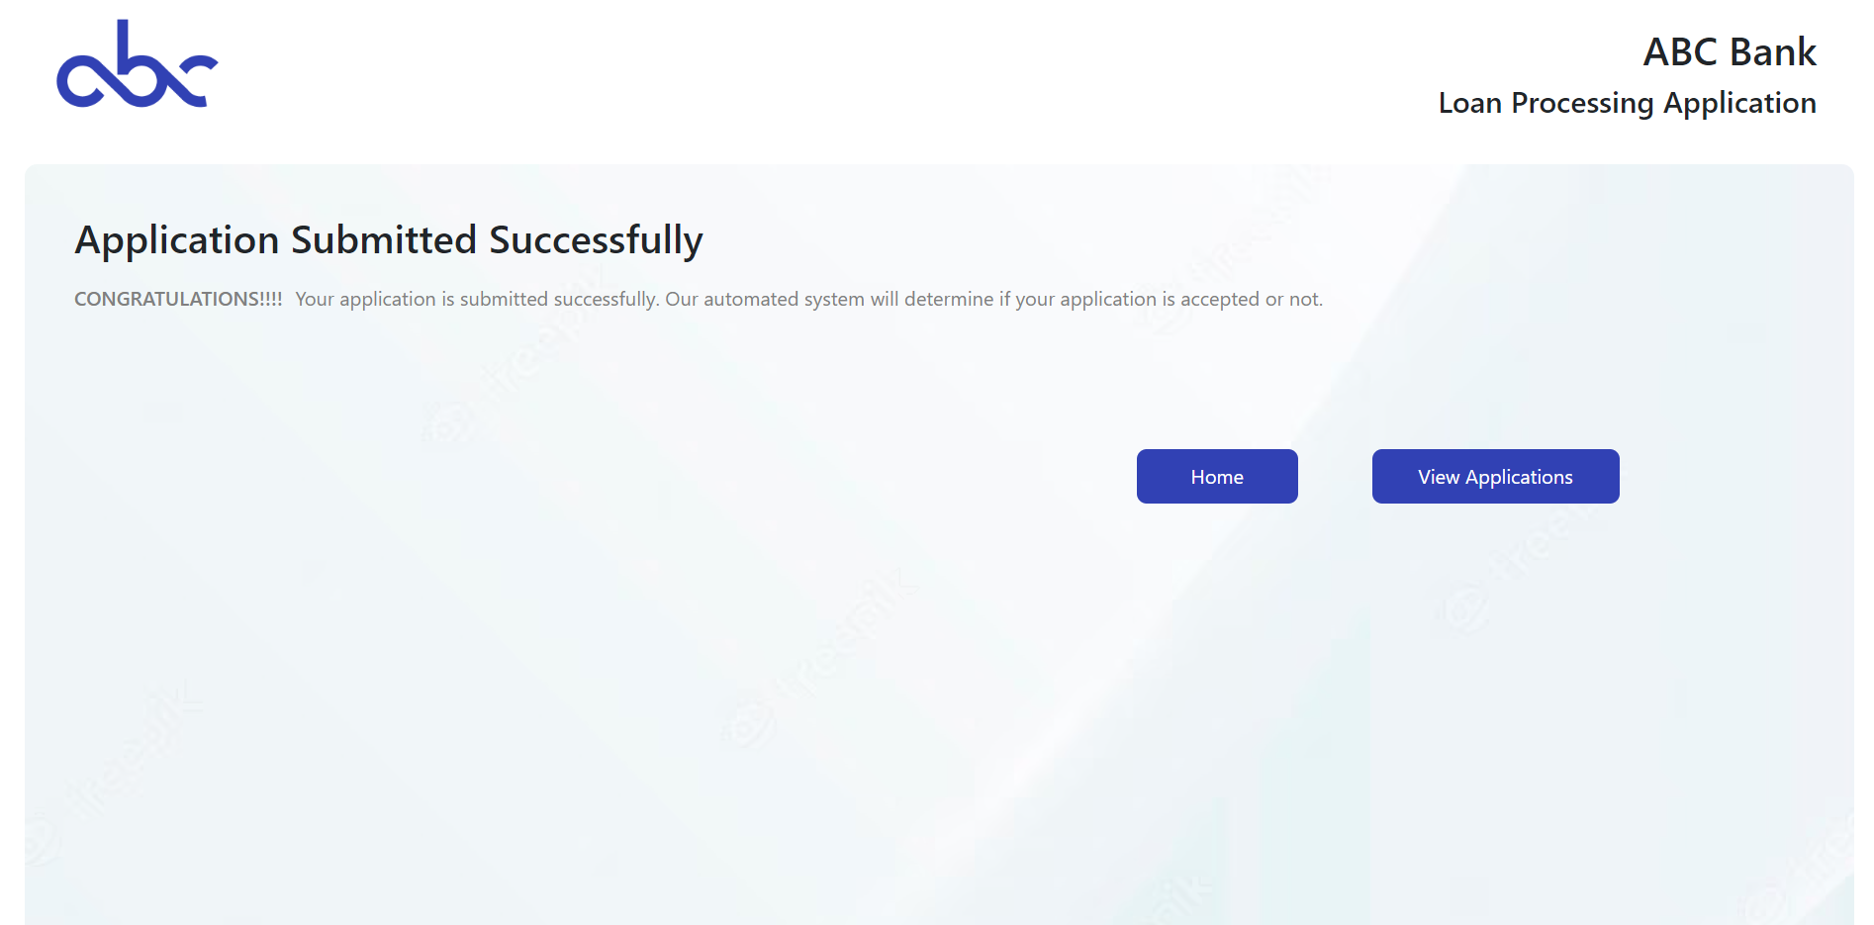
Success Components
Displays message for successful application submission.
Home - > Welcome Component
View applications.

Slide 13
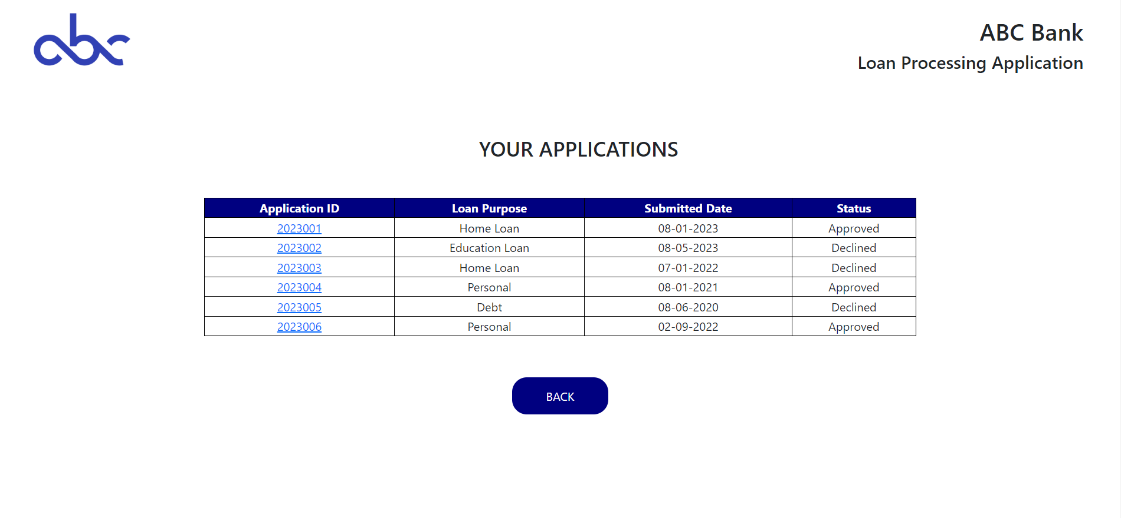
View Applications Components
Displays all submitted applications
Back - > Welcome Component
Application ID -> Specific Application

Slide 14
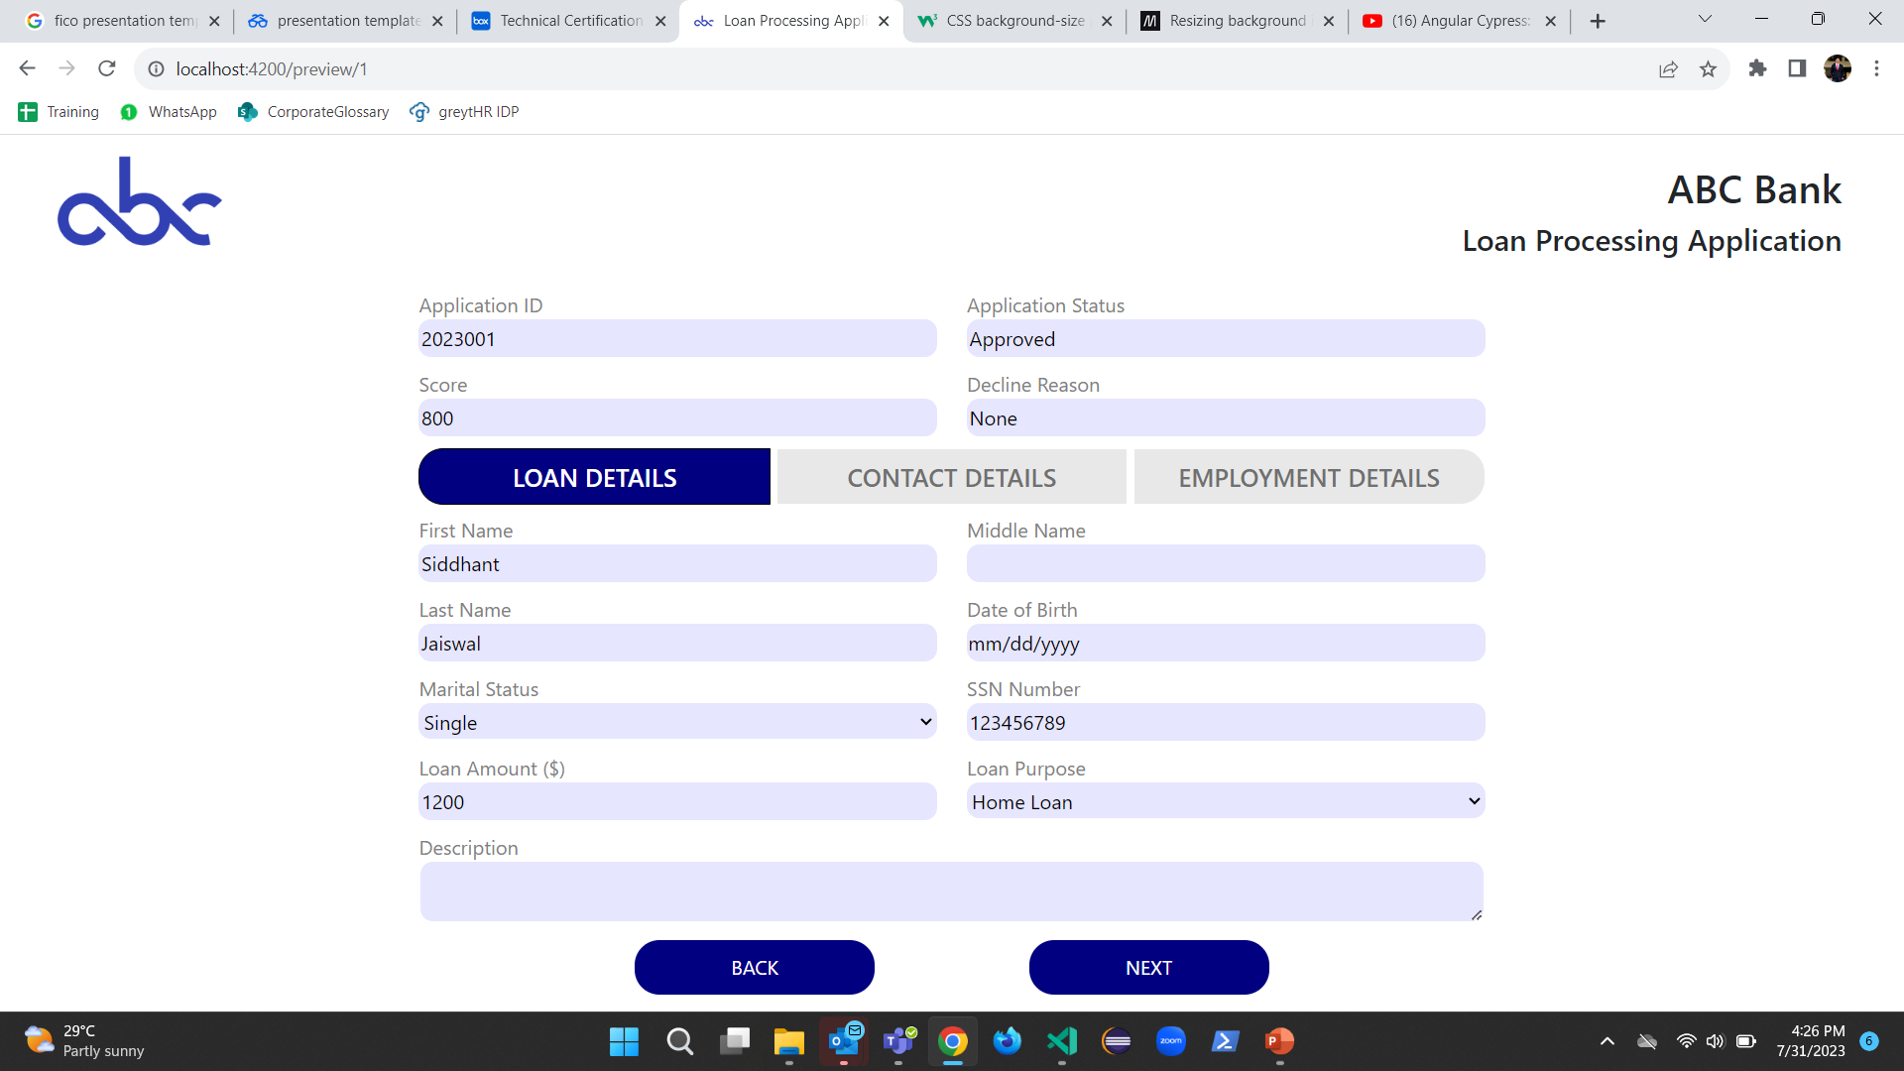
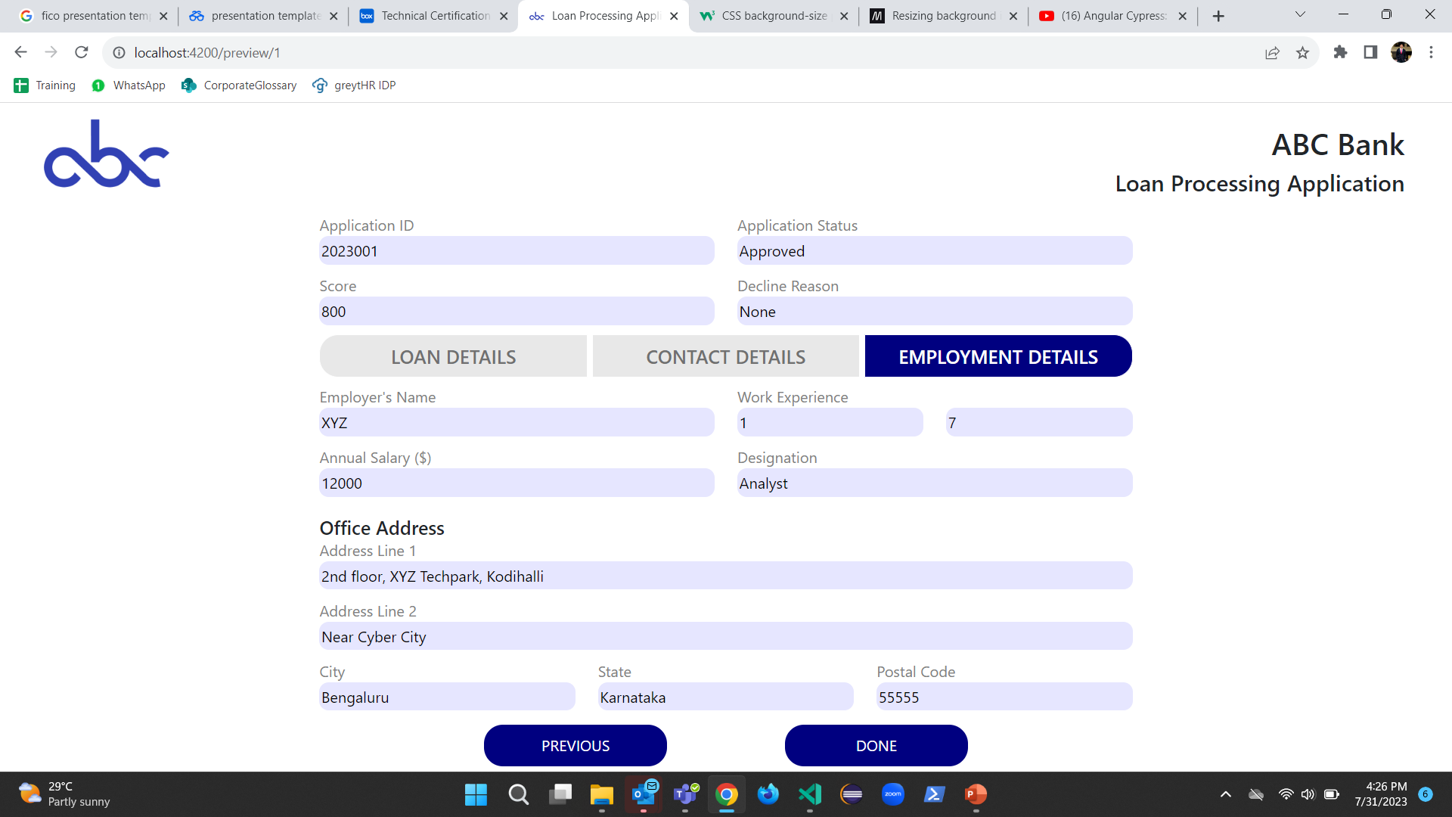
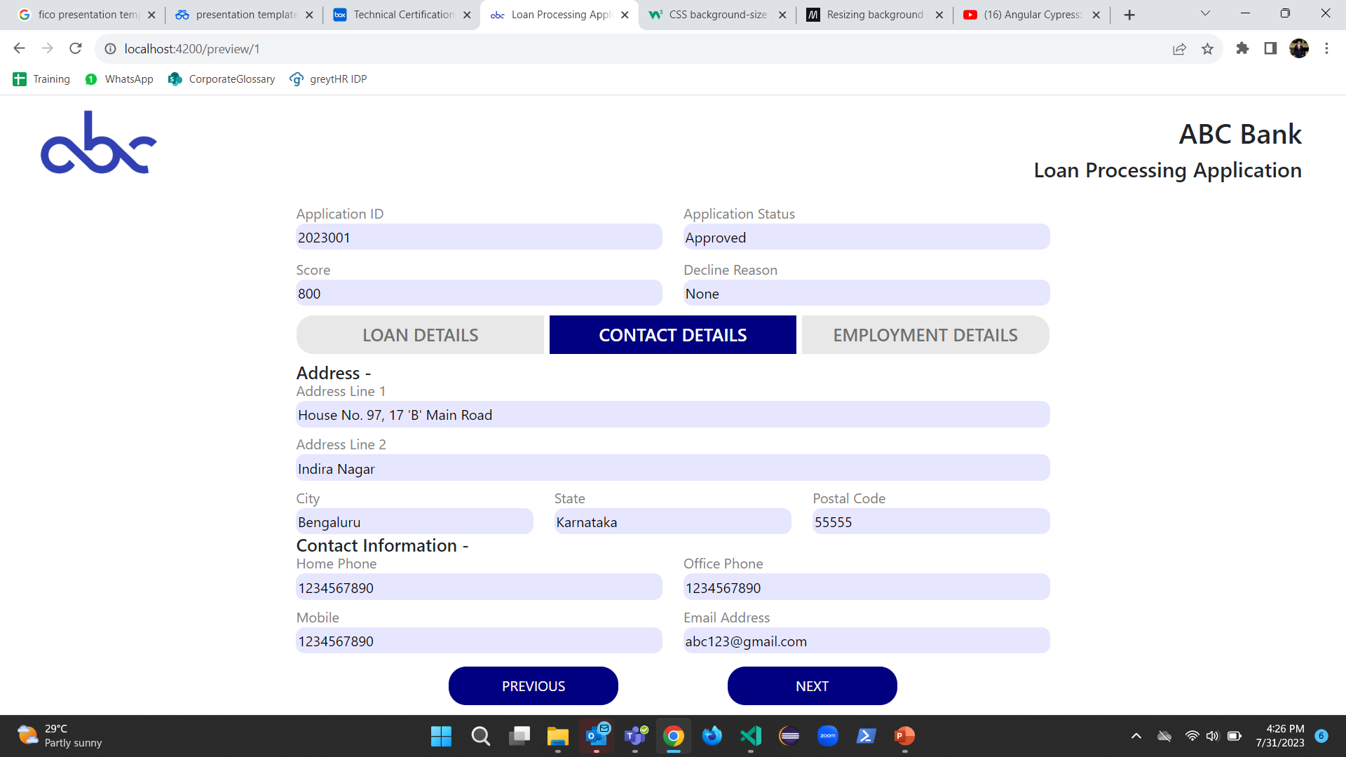
Preview Applications Components
Preview each application using the Application ID
Done - > Welcome Component
Read-only attributes

Slide 15
Back-end

Slide 16
Model Development

Slide 17
Model Development Process
1
Problem Description
2
Gathering
Data
3
Data
Preparation
4
Exploratory
Data Analysis
5
Train
Model
6
Test
Model
7
Evaluation
8
Deployment

Slide 18
Problem Description
A model needs to be developed which correlates their underlying profile and predicts whether the application should be accepted or rejected.
Loan Details (Provided by User) Bureau Data (From SSN Number)
Feature | Value
Loan Amount | $30,000
Employment Length | 1
Annual Income | $93,000
Purpose | Debt
Description | This loan is for business and ..
Feature | Value
Delinquency | 1
Inquiries | 0
Months since last Delinquency | 10
Open Records | 11
Public Records | 0
Feature | Value
Months since last Record | 130
Revolving Bal. | $38,928
Revolving Util. | 0.85
Total Accounts | 36
Earliest Credit Line | 10/07/1983
User
SSN No.
152755
>=Th.
Accepted
Data
Preprocessing
Logistic
Regression
Probability
Threshold Score:
Identify the threshold score for which the decline rate is similar to the default rate in the training data.
<Th.
Rejected

Slide 19
Gathering Data
The Modeling Dataset provided for the project consists of 15,000 rows/instances and 17 columns, out of which 15 will be used as features for training the model and the “loan_status” column will be used as target.
Summary of the Dataset
Feature | Description
id | SSN Number
loan_amnt | The listed amount of the loan applied for by the borrower
emp_length | Employment length in years.
annual_inc | The annual income provided by the borrower.
delinq_2yrs | The number of 30+ days past due incidences of delinquency in past 2 years.
inq_last_6mths | The no. of inquiries by creditors during the past 6 months.
mths_since_last_delinq | The number of months since the borrower’s last delinquency.
mths_since_last_record | The number of months since the last public record.
Feature | Description
open_acc | The number of open credit lines in the borrower’s credit file.
pub_rec | No. of derogatory public records.
revol_bal | Total credit revolving balance.
revol_util | Revolving line utilization rate
total_acc | The total number of credit lines currently in the borrower’s credit file
earliest_cr_line | The date the borrower’s earliest reported credit line was opened.
purpose | Loan purpose category
desc | Loan Description
loan_status | Current Status of the loan.

Slide 20
Data Preprocessing
Loan Status shows the current loan status of all the customers of that bank. The Loan Status has following values: “Charged Off”, “Current”, “Default”, “Fully Paid”, “In Grace Period”, “Late (16 – 30 days)”, “Late (31 – 120 days)”. We need to transform loan_status to a binary variable : ”Good” and “Bad”.
Assumptions | Loan Status | Condition | Target Variable | Loan Status Description
Assumption 1 | Charged Off |  | Bad | Lender has declared the debt as unlikely to be repaid and considers it as a loss.
Assumption 2 | Current | Delinquency <= 1 | Good | Borrower is up-to-date on all scheduled loan payments
Assumption 3 |  | Delinquency >= 2 | Bad
Assumption 4 | Default |  | Bad | Borrower has failed to meet the agreed-upon loan payment terms, and the loan is considered delinquent.
Assumption 5 | Fully Paid | Delinquency >= 3 | Bad | Borrower has successfully repaid the entire loan amount, and the loan is considered settled and closed.
Assumption 6 |  | Delinquency <= 2 | Good
Assumption 7 | In Grace Period | Delinquency <= 1 | Good | Borrower is temporarily allowed to make a late payment without incurring penalties or defaulting on the loan.
Assumption 8 |  | Delinquency >= 2 | Bad
Assumption 9 | Late (16 – 30 days) | Delinquency <= 1 | Good | Borrower has missed the payment deadline by 16 to 30 days and is in the early stages of delinquency.
Assumption 10 |  | Delinquency >= 2 | Bad
Assumption 11 | Late (31 – 120 days) |  | Bad | Borrower has missed the payment deadline by 31 to 120 days

Slide 21
Data Preprocessing
Loan Purpose in the Modeling Dataset contains different categorical values such as “Major Purchase”, “Medical”, “Debt Consolidation”, etc. But, as per Validation in deployment we will get only four types of loan purposes namely “debt”, “educational loan”, “personal loan”, “home loan”. So now we need to group the loan purposes into these 4 categories only.
Assumption 12
Assumption 13
Personal Loan
Car
Credit Card
Major Purchase
Medical
Moving
Other
Renewable Energy
Small Business
Vacation
Wedding
Debt
Debt Consolidation
Categorical
Variable
Assumption 14
Label Encoding
One-hot Encoding
Risk Variable
Education Loan
Educational
Risk Variable
Purpose | Good | Bad | Total | Risk
Debt | 6101 | 1000 | 7101 | 0.1408
Personal | 5552 | 912 | 6464 | 0.1411
Home | 1155 | 158 | 1313 | 0.1203
Educational | 93 | 29 | 122 | 0.2377
Assumption 15
Home Loan
House
Home Improvement

Slide 22
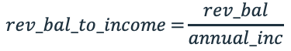
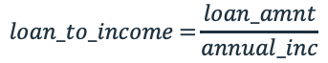
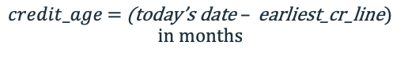
Data Preprocessing
Derived variables, also known as feature engineering or new feature creation, is a crucial step in preparing data for machine learning models. It involves creating new features from existing ones to improve the model's predictive power.
1. Loan to Income Ratio
2. Revolving Balance to Income Ratio
3. Credit Age (in Months)
This can be valuable for assessing the borrower's creditworthiness and financial stability. The ratio provides an indication of the borrower's ability to manage their debt obligations relative to their income level.
$$loan_to_income\text{ =}\frac{loan_amnt}{annual_inc}$$
$$rev_bal_to_income\text{ =}\frac{rev_bal}{annual_inc}$$
It provides insights into the borrower's debt-to-income ratio, which is an essential factor for lenders to determine a borrower's ability to repay loans and manage credit responsibly.
The credit age provides insight into a borrower's credit history and how long they have been using credit. A longer credit age is generally seen as a positive factor because it demonstrates that the borrower has a more established credit history.
$$credit_age\text{ = }\text{(}\text{today}\text{’}\text{s} \text{date} – \text{earliest}\text{_}\text{cr}\text{_}\text{line}\text{) }$$
$$\text{in} \text{months}$$

Slide 23
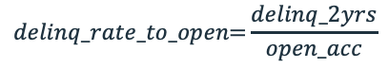
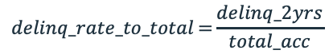
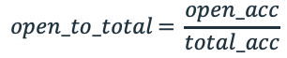
Data Preprocessing
Derived variables, also known as feature engineering or new feature creation, is a crucial step in preparing data for machine learning models. It involves creating new features from existing ones to improve the model's predictive power.
4. Delinquency per Account (Total)
5. Delinquency per Account (Open)
6. Open to Total Accounts
$$delinq_rate_to_total\text{ =}\frac{delinq_2yrs}{total_acc}$$
This feature provides valuable information about the borrower's recent payment behavior and their ability to meet their credit obligations on time. A higher value suggests that a significant percentage of the borrower's accounts have experienced delinquency in the past two years. This could indicate financial stress, a higher risk of default, and a potentially lower creditworthiness.
$$delinq_rate_to_open\text{=}\frac{delinq_2yrs}{open_acc}$$
This provides insights into how a person manages their credit and can be indicative of their creditworthiness. The ratio helps lenders and credit scoring models assess the individual's financial health and risk level.
$$open_to_total\text{ = }\frac{open_acc}{total_acc}$$

Slide 24
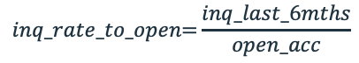
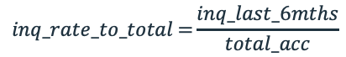
Data Preprocessing
Derived variables, also known as feature engineering or new feature creation, is a crucial step in preparing data for machine learning models. It involves creating new features from existing ones to improve the model's predictive power.
7. Inquiries per Account (Total)
8. Inquiries per Account (Open)
$$inq_rate_to_total\text{ =}\frac{inq_last_6mths}{total_acc}$$
This ratio provides insights into how frequently a person applies for new credit in relation to the total number of credit accounts they have.
A higher inquiries per account ratio suggests that a person has been actively seeking new credit or taking on more debt. This can be seen as a potential risk factor to lenders because multiple credit inquiries within a short period may indicate a higher likelihood of financial stress or overextension of credit.
$$inq_rate_to_open\text{=}\frac{inq_last_6mths}{open_acc}$$

Slide 25
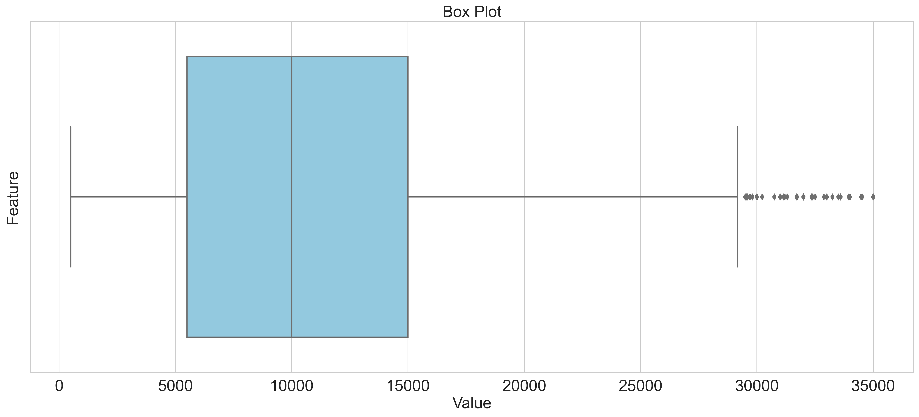
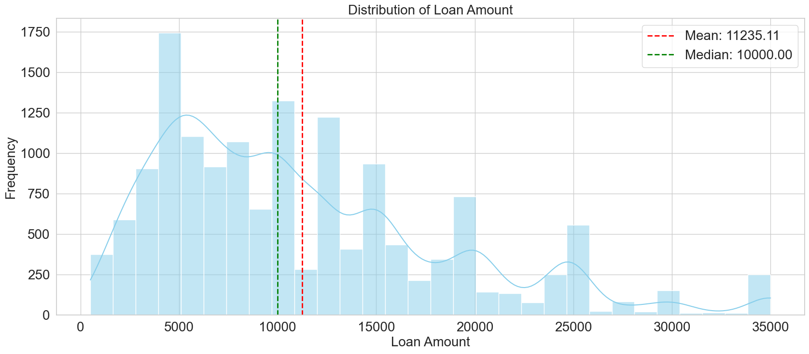
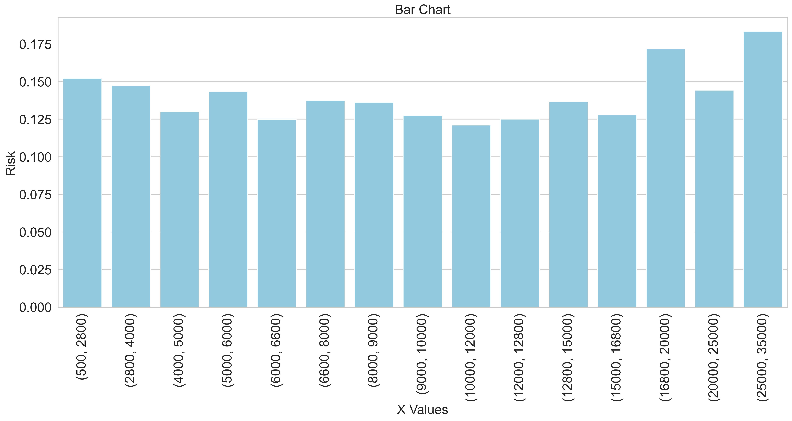
Exploratory Data Analysis – Loan Amount
Box Plot
Minimum
500
Maximum
35,000
Mean
11,235
Median
10,000
Std. Deviation
7,417
Variance
55,016,494
Frequency Distribution Risk Distribution

Slide 26
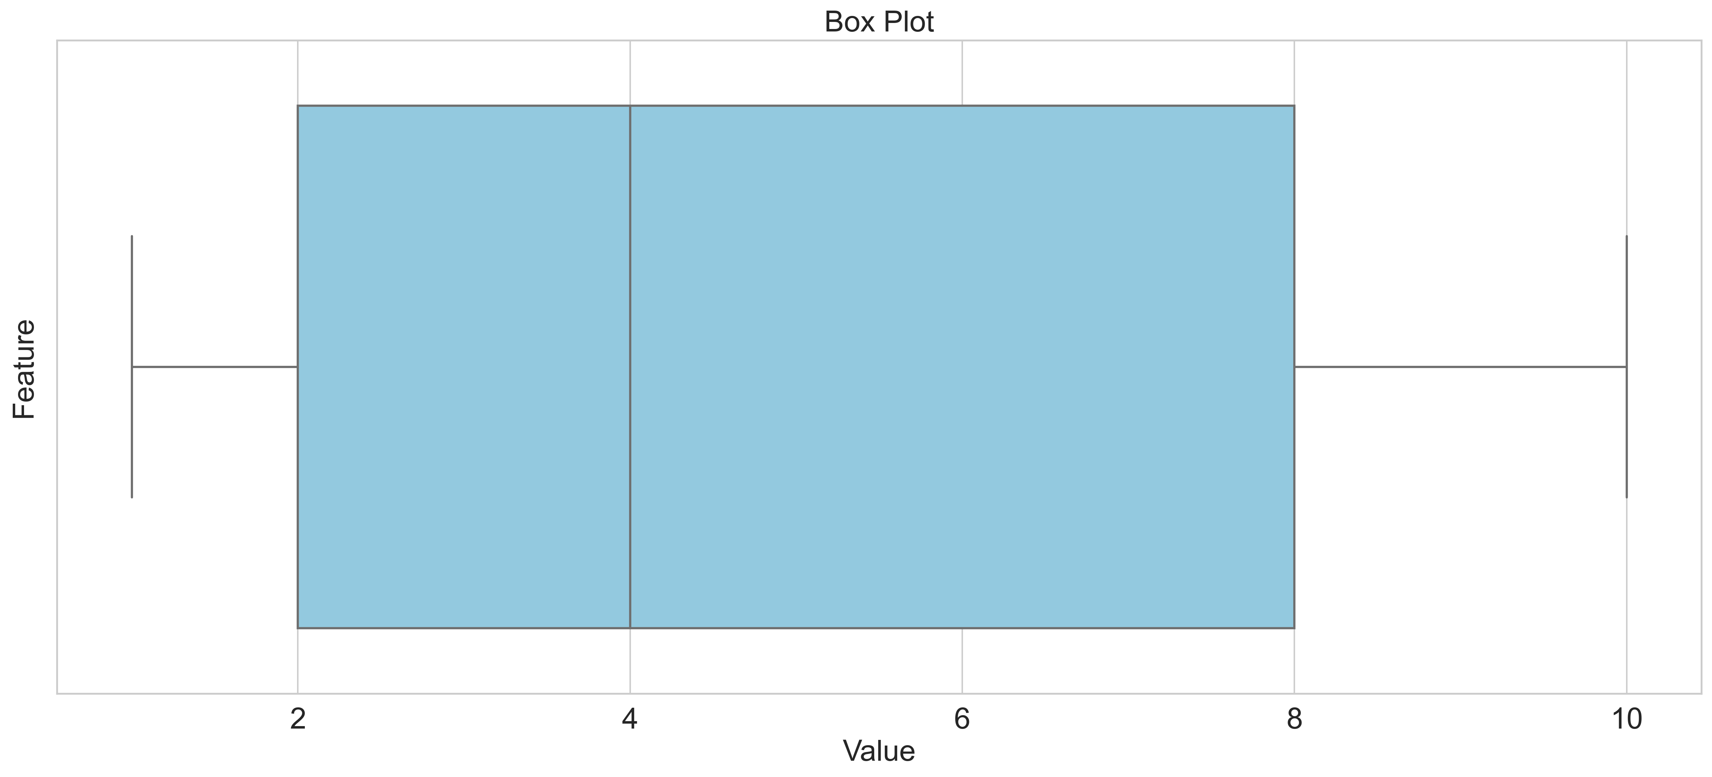
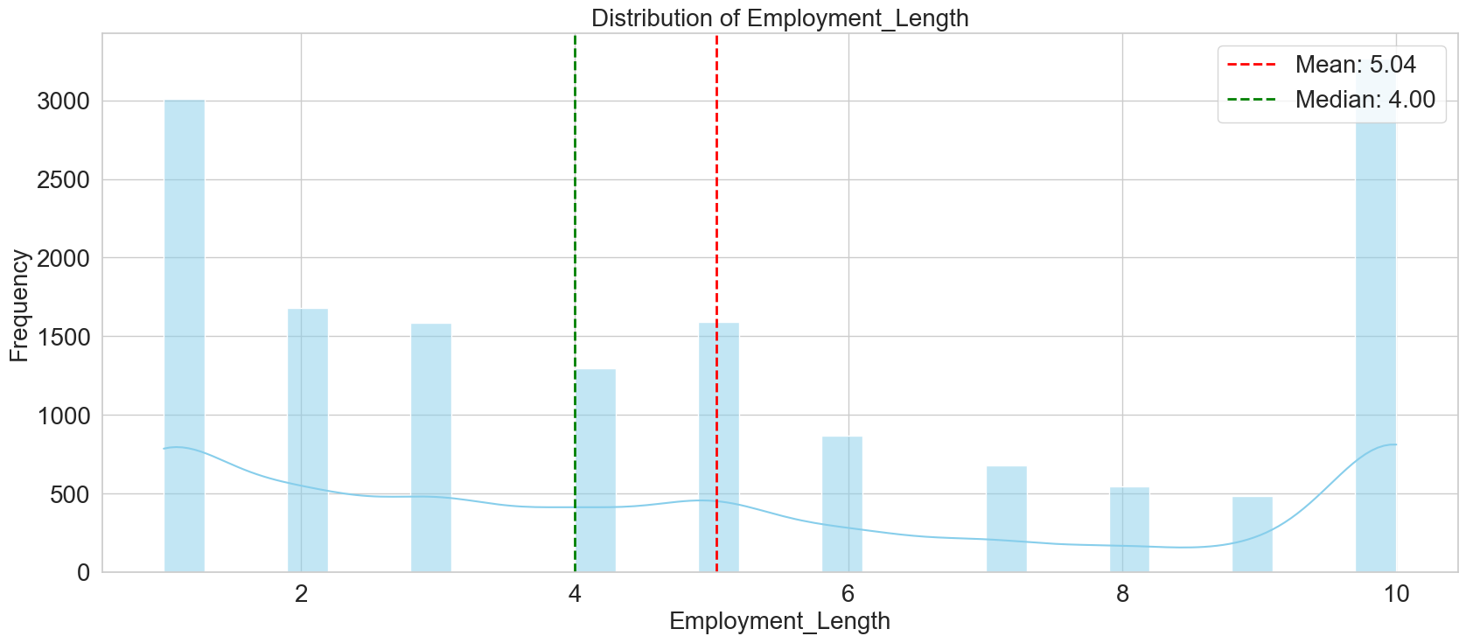
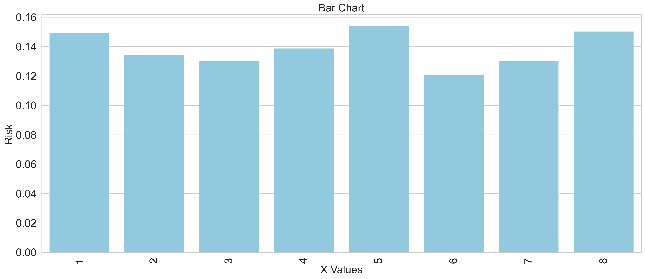
Exploratory Data Analysis – Employment Length
Box Plot
Minimum
1
Maximum
10
Mean
5.0376
Median
4
Std. Deviation
3.3528
Variance
11.2417
Frequency Distribution Risk Distribution

Slide 27
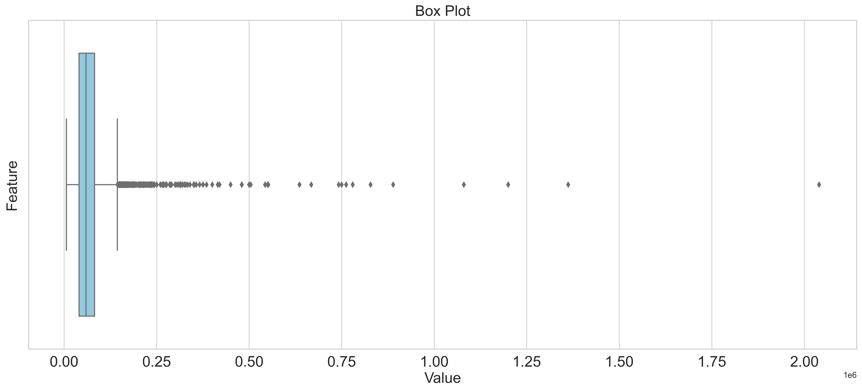
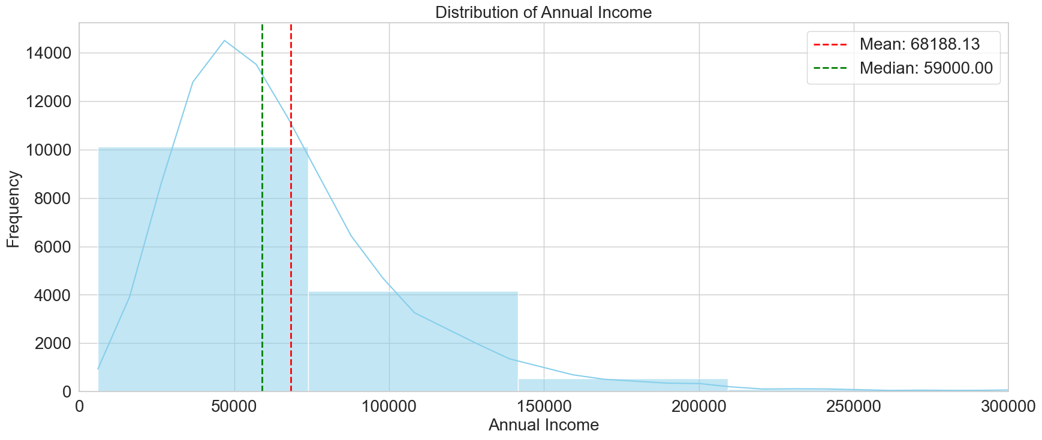
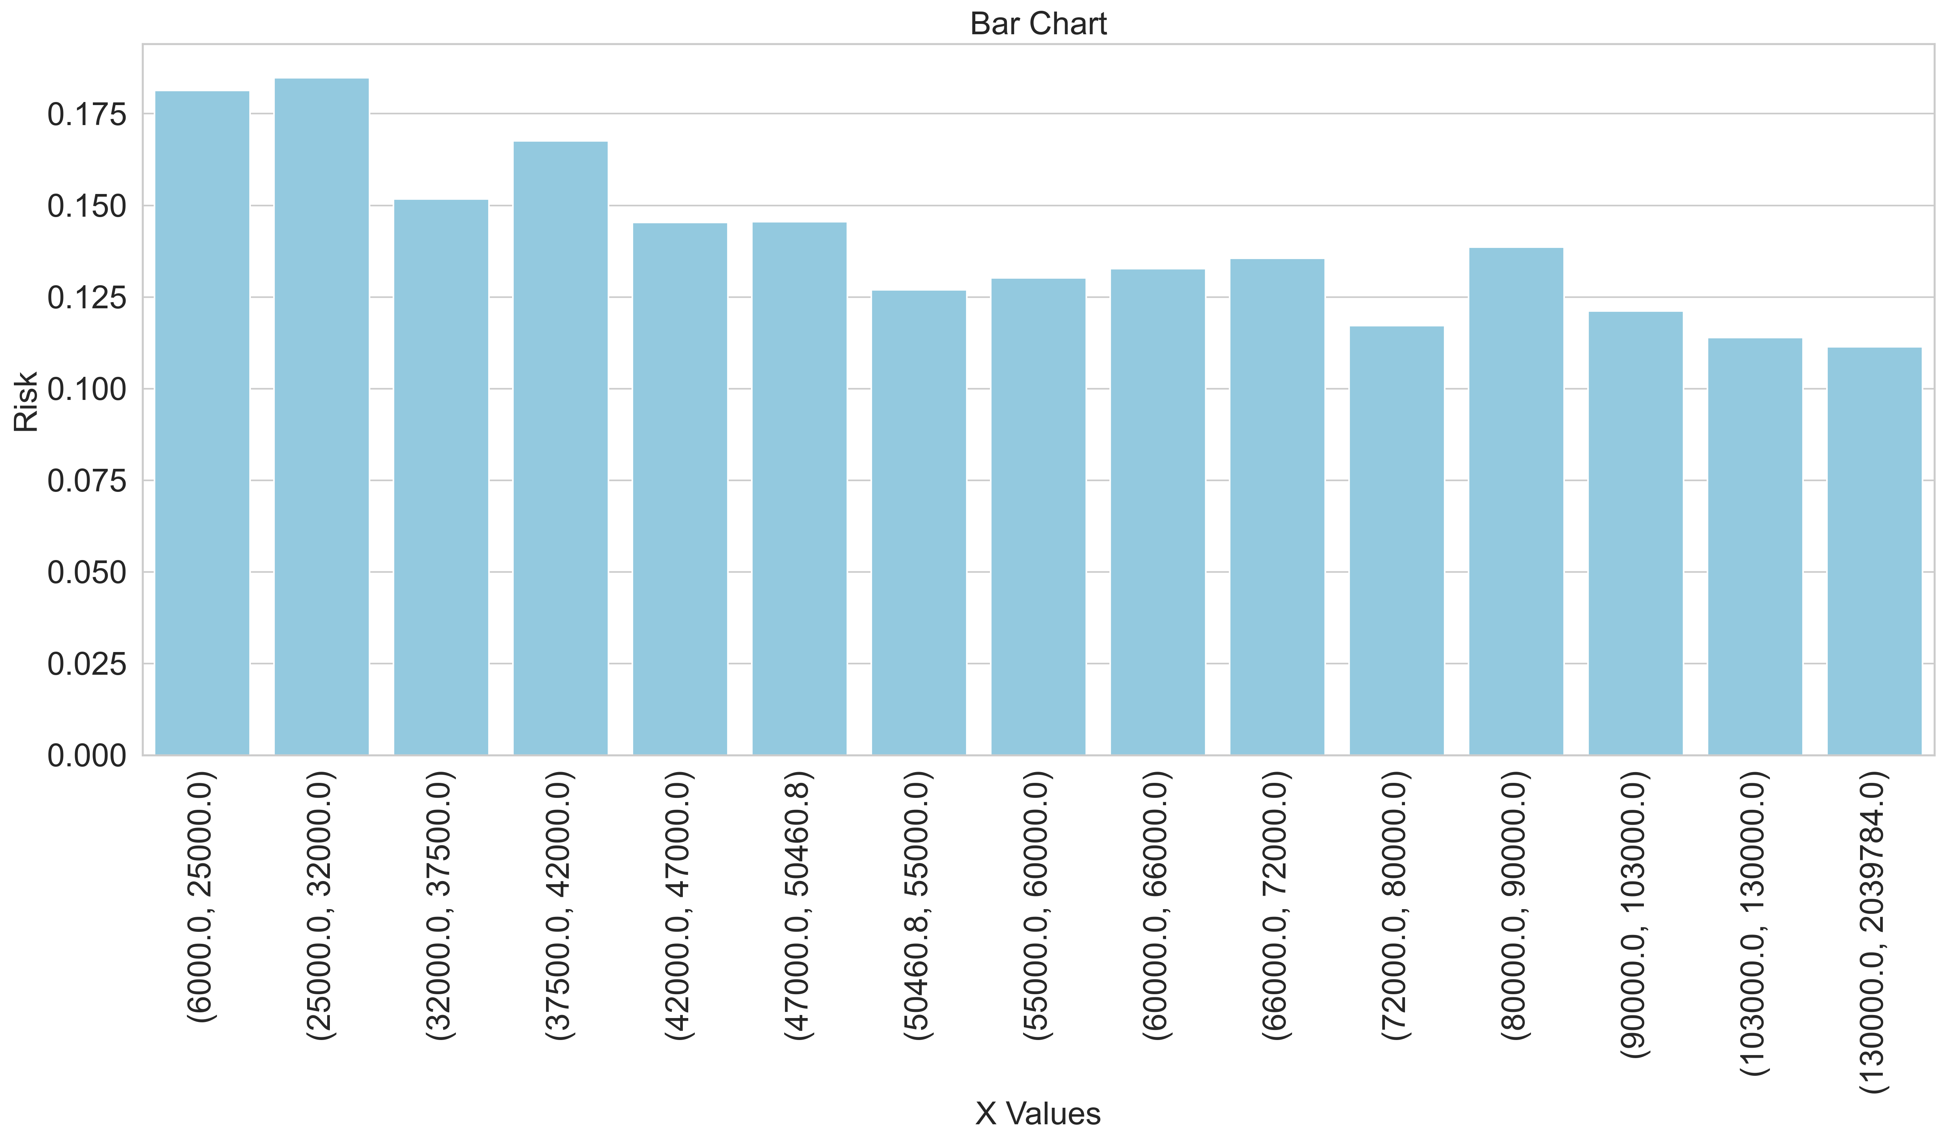
Exploratory Data Analysis – Annual Income
Box Plot
Minimum
6,000
Maximum
20,39,784
Mean
68,188
Median
59,000
Std. Deviation
51,012
Variance
2,602,289,387
Frequency Distribution Risk Distribution

Slide 28
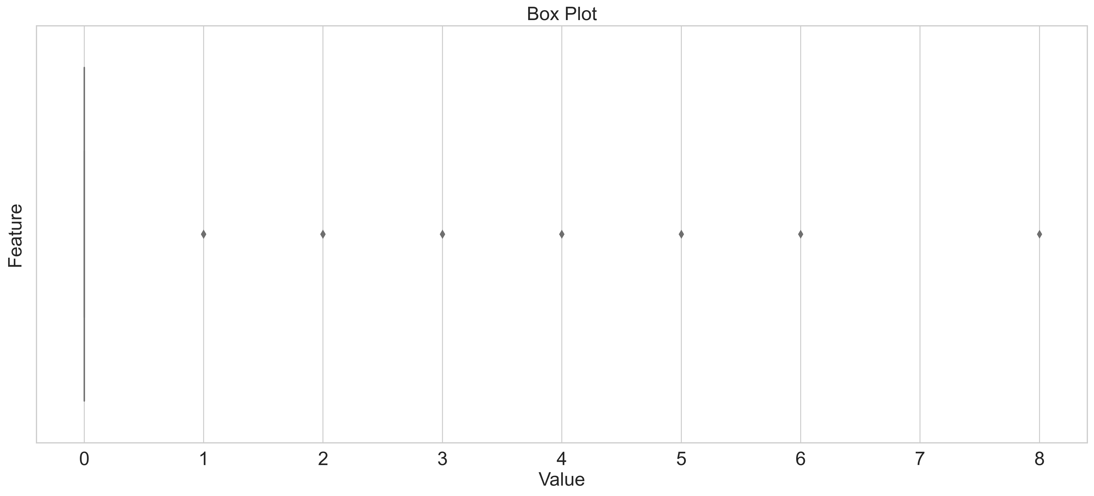
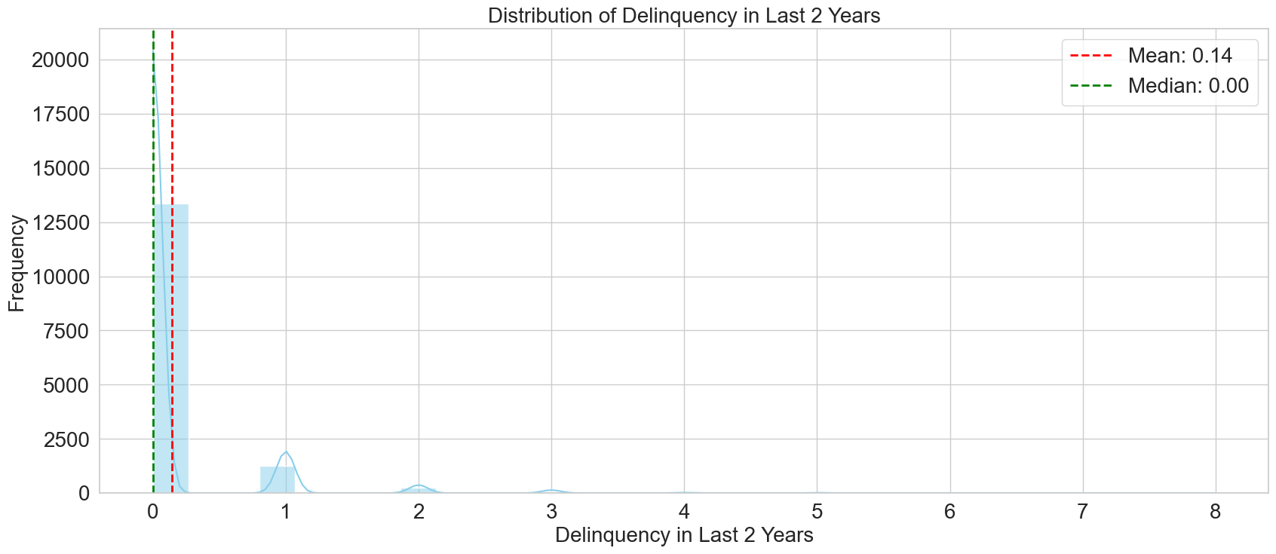
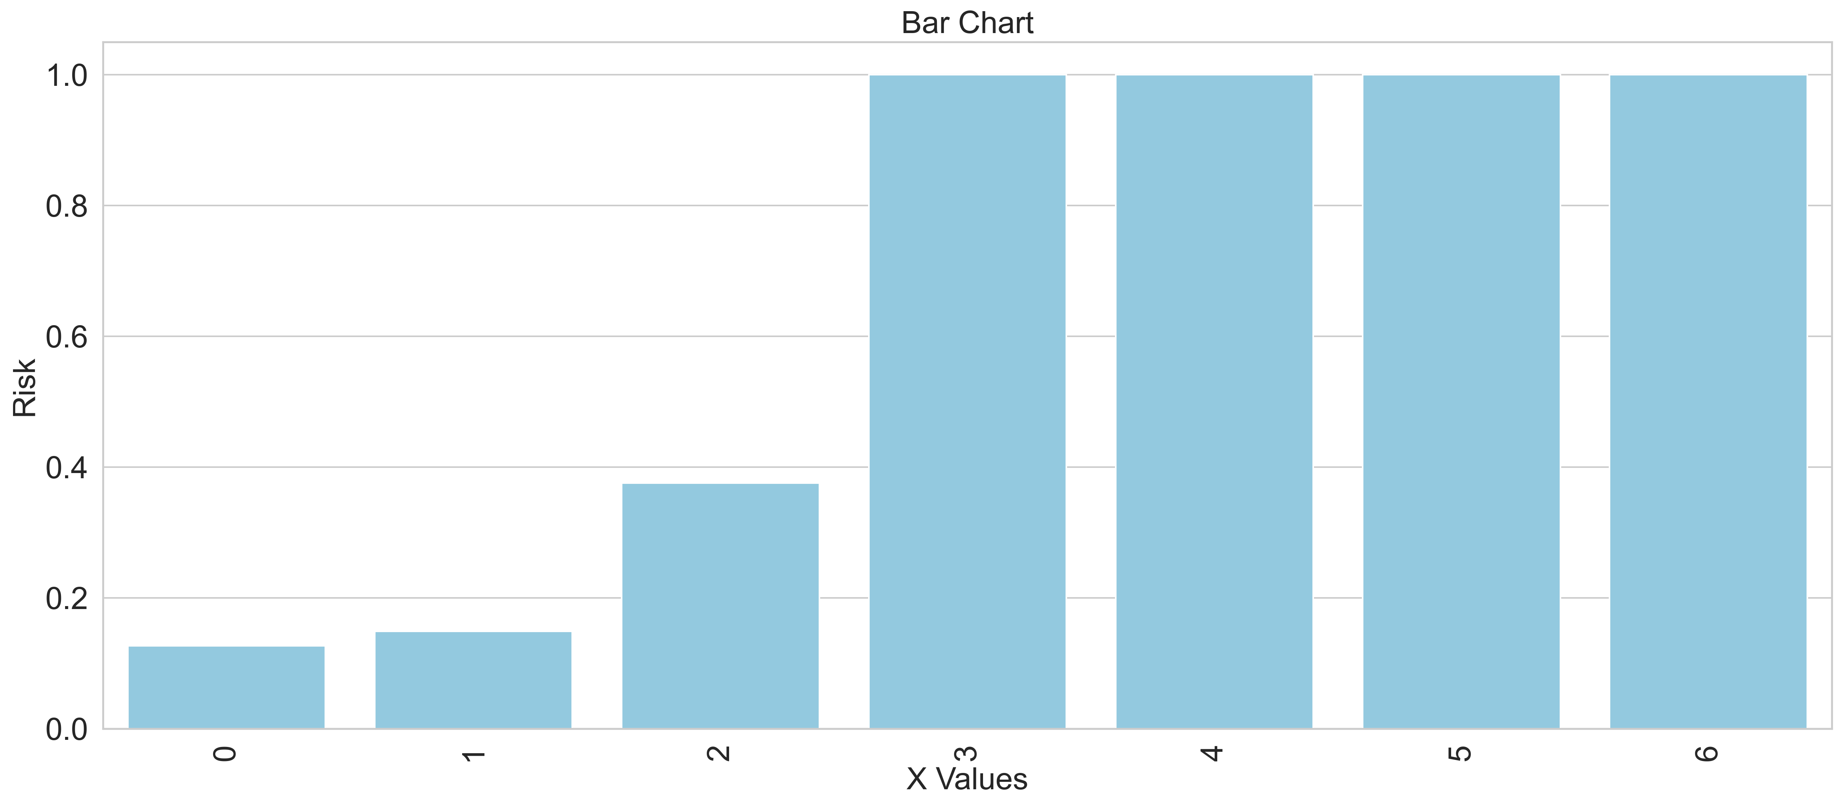
Exploratory Data Analysis – Delinquency in Last 2 Years
Box Plot
Minimum
0
Maximum
8
Mean
0.1436
Median
0
Std. Deviation
0.4772
Variance
0.2277
Frequency Distribution Risk Distribution

Slide 29
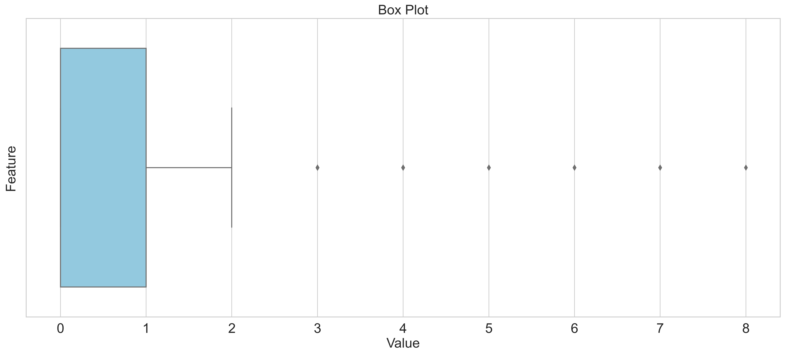
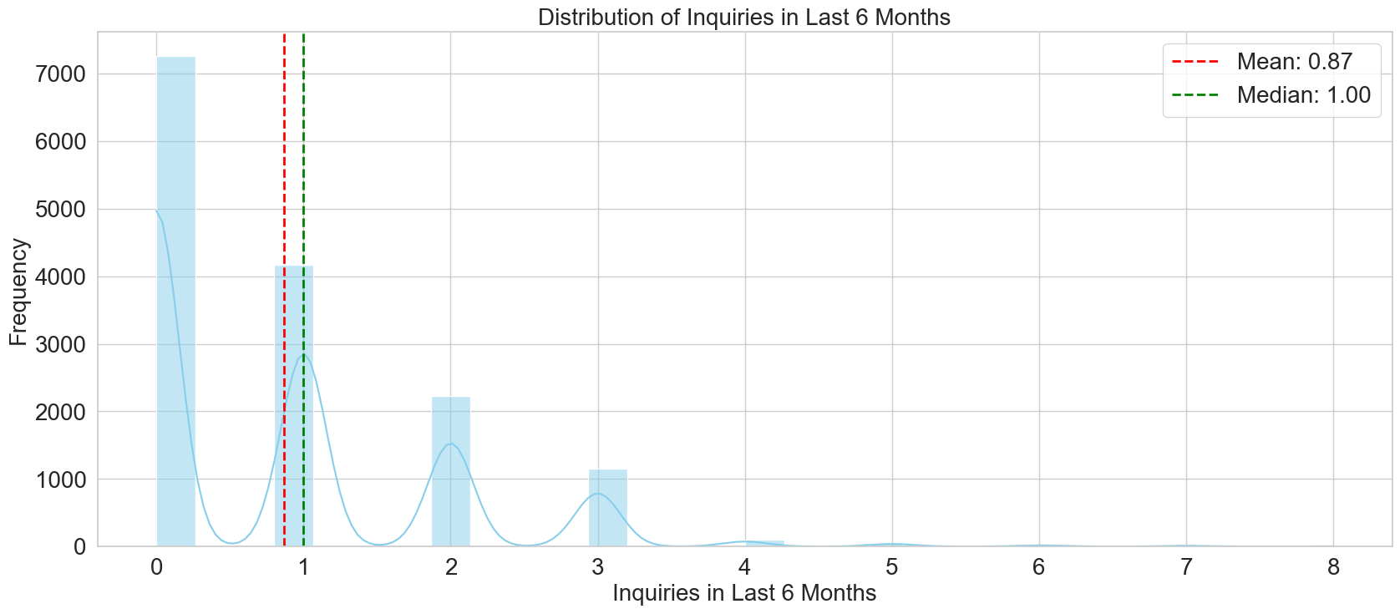
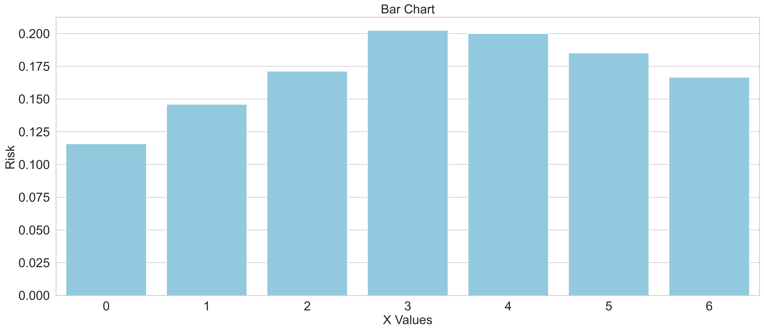
Exploratory Data Analysis – Inquiries Last 6 Months
Box Plot
Minimum
0
Maximum
8
Mean
0.8691
Median
1
Std. Deviation
1.0628
Variance
1.1296
Frequency Distribution Risk Distribution

Slide 30
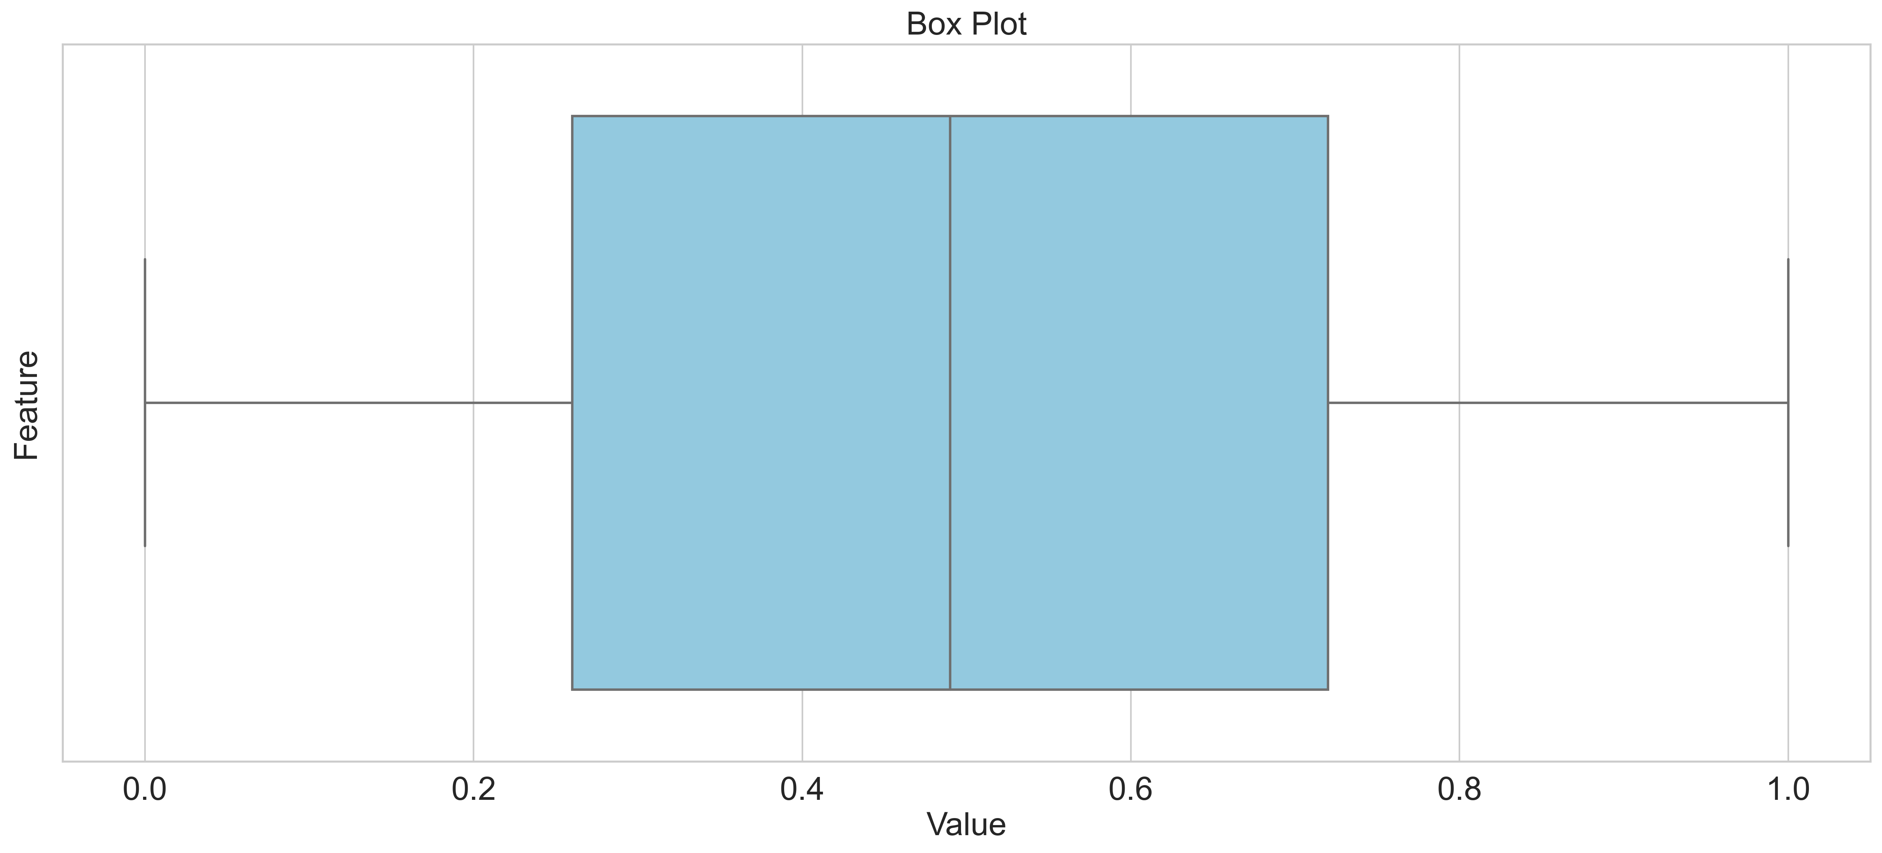
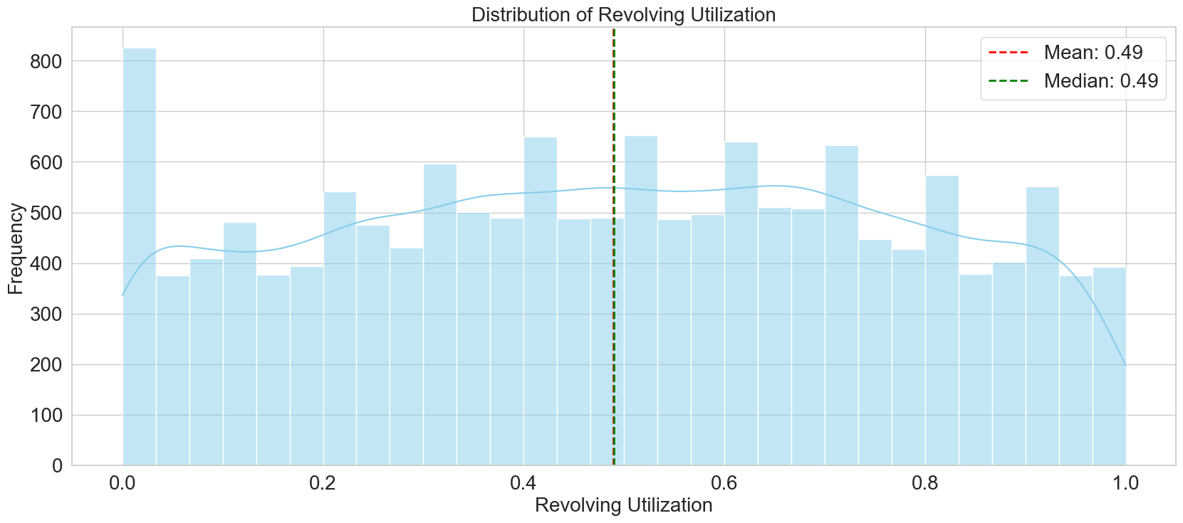
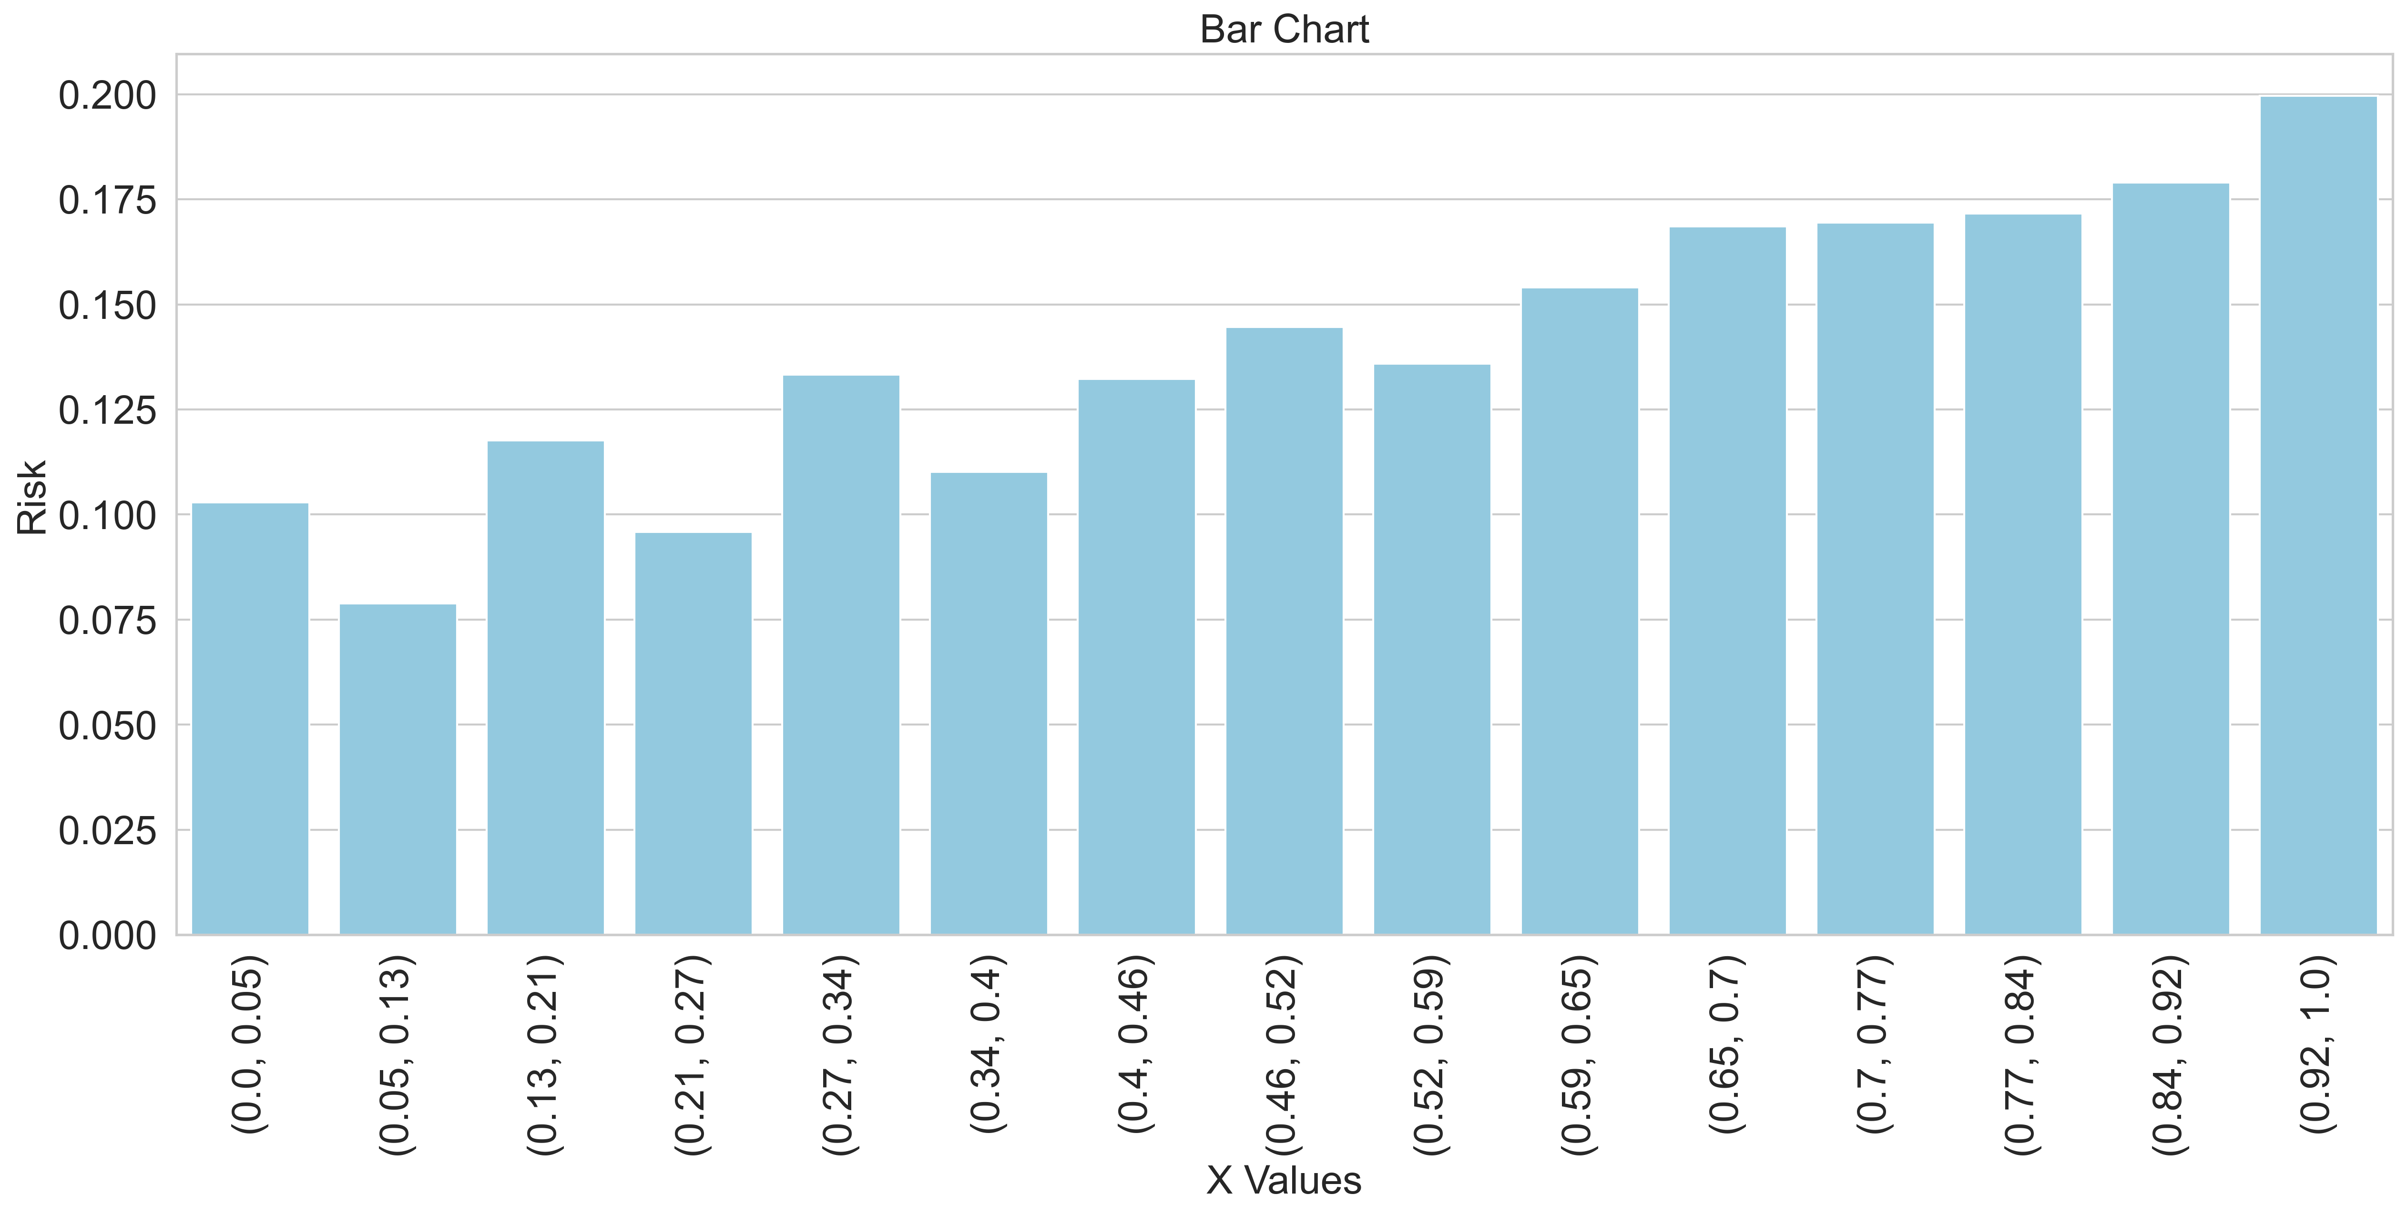
Exploratory Data Analysis – Revolving Utilization
Box Plot
Minimum
0
Maximum
1
Mean
0.4895
Median
0.49
Std. Deviation
0.2826
Variance
0.0799
Frequency Distribution Risk Distribution

Slide 31
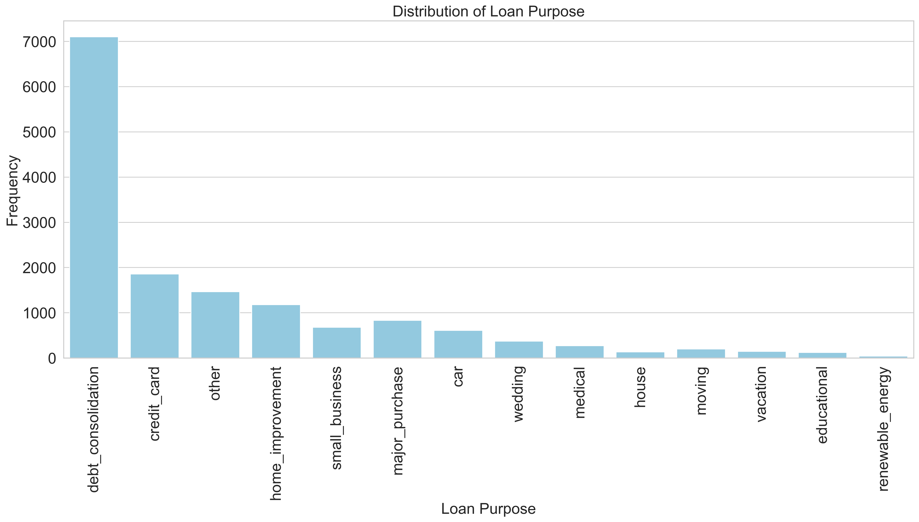
Exploratory Data Analysis – Loan Purpose
Pie Plot
Debt Personal Loan
Home Loan Educational Loan
Debt
7101
Personal Loan
6464
Home Loan
1313
Educational Loan
122
Frequency Distribution

Slide 32
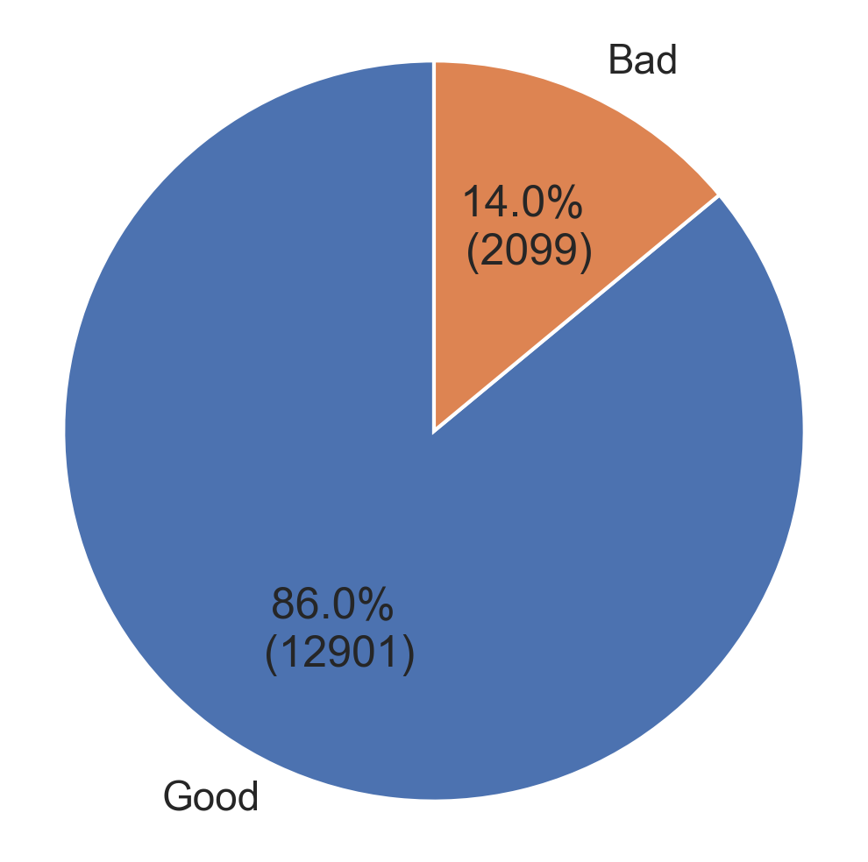
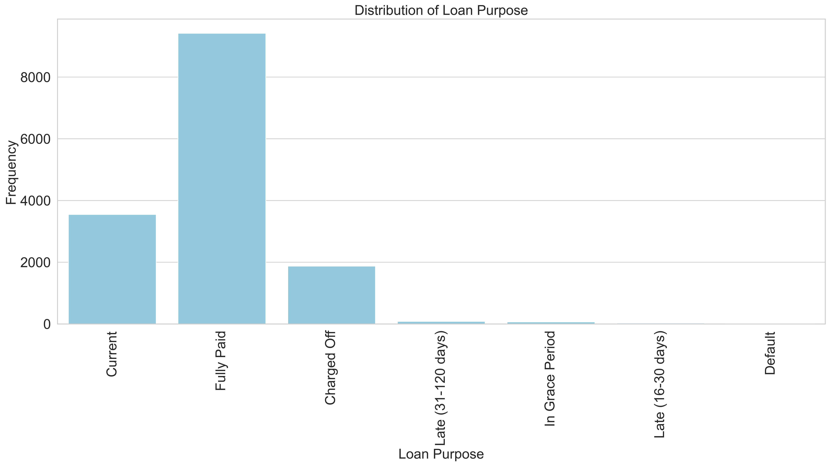
Exploratory Data Analysis – Loan Purpose
Target Variable
Good Loans
12901
Bad Loans
2099
Good Loans %
86%
Bad Loans %
14%
Frequency Distribution
It is evident that the target variable is unbalanced, with “Good” class having significantly higher representation than “Bad”. This class imbalance can lead to biased model performance, where the algorithm tends to favor the majority class, potentially overlooking patterns within the minority classes. To address this issue, it is essential to implement strategies that mitigate the impact of class imbalance.

Slide 33
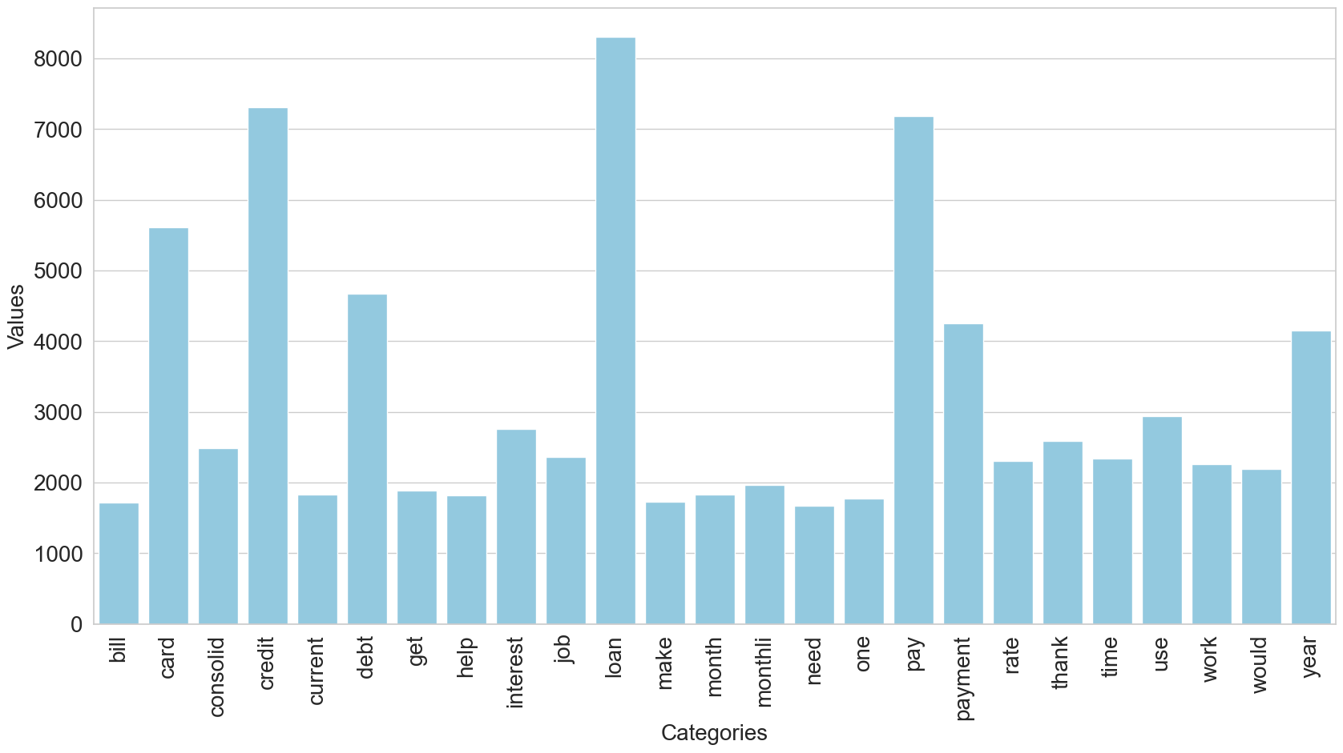
Exploratory Data Analysis – Loan Description
Frequency Distribution
Matrix
bill | card | consolid | … | would | year
1 | 0 | 1 |  | 0 | 0
0 | 1 | 1 |  | 1 | 0
0 | 0 | 1 |  | 0 | 1
1 | 1 | 1 |  | 0 | 0
1 | 0 | 0 |  | 1 | 0
0 | 0 | 0 |  | 0 | 1
Coefficients
Model
Word | Coefficient
bill | -0.2290
card | 0.0144
consolid | -0.0334
credit` | 0.1844
Word | Coefficient
current | 0.0927
debt | -0.0053
get | 0.0470
help | -0.1862
Matrix
Logistic
Regression
Risk Value

Slide 34
Model Training
Dataset : Dividing Dataset into X(Independent Variables) and Y(Dependent Variable)
s.no. | id | loan_amnt | emp_ length | annual_ inc | delinq_ 2yrs | inq_last_ 6mths | … | inq_rate_ to_open | pub_rec_ rate | loan_status
1 | 1002603 | 30000 | 1 | 93000 | 0 | 1 | … | 0.1000 | 0 | Good
2 | 1024806 | 22000 | 6 | 70000 | 1 | 0 | … | 0 | 0 | Good
3 | 663413 | 3700 | 10 | 117000 | 1 | 1 | … | 0.1111 | 0 | Good
4 | 810093 | 7600 | 1 | 33996 | 0 | 0 | … | 0 | 0 | Good
5 | 865474 | 12000 | 7 | 75000 | 0 | 1 | … | 0.0769 | 0 | Good
… | … | … | … | … | … | … | … | … | … | …
… | … | … | … | … | … | … | … | … | … | …
… | … | … | … | … | … | … | … | … | … | …
15000 | 615476 | 15250 | 5 | 36000 | 0 | 1 | … | 0.0769 | 0 | Good
X
(Independent Variables)
Y
(Dependent Variable)

Slide 35
Model Training
Train Test Split: Splitting the dataset into training and test set with the test size being 0.3 or 30%.
loan_amnt | emp_ length | annual_ inc | … | inq_rate_ to_open | pub_rec_ rate | loan_status
30000 | 1 | 93000 | … | 0.1000 | 0 | Good
22000 | 6 | 70000 | … | 0 | 0 | Good
3700 | 10 | 117000 | … | 0.1111 | 0 | Good
7600 | 1 | 33996 | … | 0 | 0 | Good
12000 | 7 | 75000 | … | 0.0769 | 0 | Good
… | … | … | … | … | … | …
… | … | … | … | … | … | …
… | … | … | … | … | … | …
15250 | 5 | 36000 | … | 0.0769 | 0 | Good
X_train
y_train
70%
70%
y_test
X_test
y_test
30%
30%
X
(Independent Variables)
Y
(Dependent Variable)

Slide 36
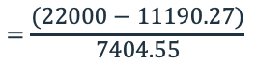
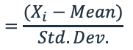
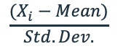
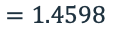
Model Training
Scaling: The primary use of scaling is to bring all features of the dataset to a similar scale or range, ensuring that no particular feature dominates the learning process simply because of its larger magnitude. Scaling facilitates a smoother and more efficient convergence during the training process and prevents certain features from having a disproportionate impact on the model’s performance.
X_train Mean
11,190.27
loan_amnt
30000
22000
3700
7600
…
…
…
15250
loan_amnt
2.5403
1.4598
-1.0116
-0.4849
…
…
…
0.5483
loan_amnt
15000
2000
30700
32900
…
…
…
17450
X_train Mean
11,190.27
loan_amnt
0.5145
-1.2412
2.6348
2.9319
…
…
…
0.8454
X_train Std Dev
7,404.55
$$\frac{(X_{i}−Mean)}{Std. Dev.}$$
$$=\frac{(X_{i}−Mean)}{Std. Dev.}$$
X_train Std Dev
7,404.55
$$=\frac{(22000−11190.27)}{7404.55}$$
X_train
X_train_scaled
X_test
X_test_scaled
$$=1.4598$$

Slide 37
Model Training
Sampling: Modeling imbalance data is the major challenge that we face when we train a model. For dealing with the classification problems the class balance of the target class label plays an important role in modeling. For imbalance class problems i.e., presence of minority class in the dataset, the models try to learn only the majority class and result in biased prediction.
The imbalance of the dataset needs to be handled before training a model. There are various techniques to handle class balance, some of them being Oversampling, Undersampling, or a combination of both. The following are 7 techniques of oversampling:
Random Over Sampling
SMOTE
BorderLine Smote
Kmeans Smote
SVM Smote
ADASYN
Smote-NC
y_train
y_train_resampled
Class | Value Counts
Bad | 1479
Good | 9021
Class | Value Counts
Bad | 9021
Good | 9021
X_train_scaled
X_train_resampled
SMOTE: Synthetic Minority Oversampling Technique
SMOTE is an oversampling technique where the synthetic samples are generated for the minority class. This algorithm helps to overcome the overfitting problem posed by random sampling. It focuses on the feature space to generate new instances with the help of interpolation between the positive instances that lie together.

Slide 38
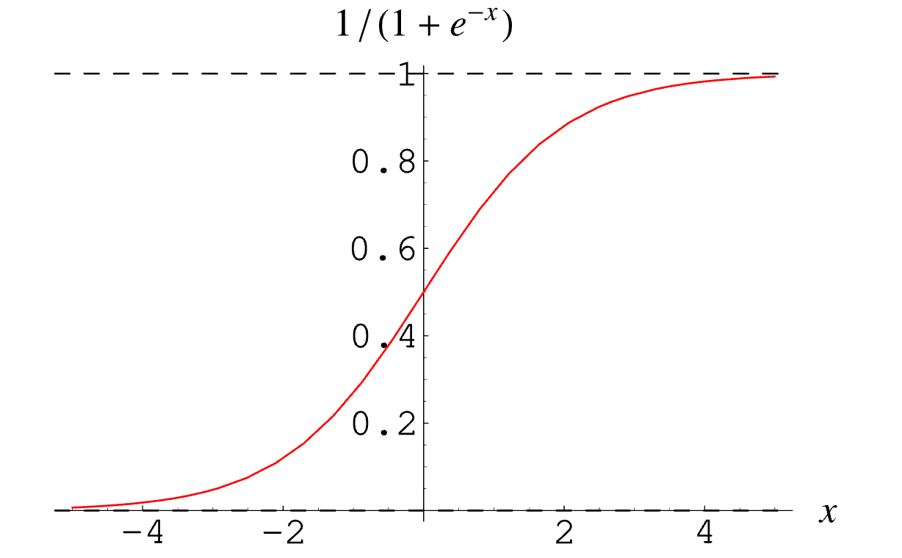
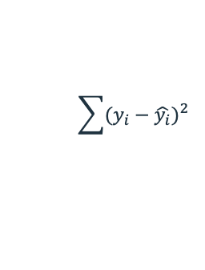
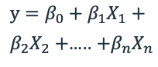
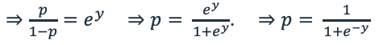
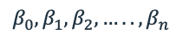




Model Training
Logistic Regression:
X_{1.} X₂ X₃ X₄ X₅ X_{n-1} X_{n} y
loan_amnt | emp_length | annual_inc | delinq_2yrs | inq_last_6mths | … | inq_rate_to_open | pub_rec_rate | loan_status
30000 | 1 | 93000 | 0 | 1 | … | 0.1000 | 0 | Good
22000 | 6 | 70000 | 1 | 0 | … | 0 | 0 | Good
… | … | … | … | … | … | … | … | …
$ln\left(\frac{p}{1−p}\right)=y=β_{0}+β_{1}X_{1}+β_{2}X_{2}+$….. $+β_{n}X_{n}$
$⇒\frac{p}{1−p}=e^{y}$ $⇒p= \frac{e^{y}}{1+e^{y}}$. $⇒p= \frac{1}{1+e^{−y}}$
$$y=β_{0}+β_{1}X_{1}+$$
$β_{2}X_{2}+$….. $+β_{n}X_{n}$
Hypothesis
$$h\left(x\right)=\frac{1}{1+e^{−(\sum{β}x+β_{0})}}$$
Minimize MSE
$$\sum{(y_{i}−\hat{y_{i}}})^{2}$$
Minimize Negative log-likelihood (NLL)
$$NLL=−\sum{[y_{i}log⁡(h\left(x_{i}\right)) +\left(1−y_{i}\right)log⁡(1−h\left(x_{i}\right))]}$$
Linear Regression:
Compute
Compute
$$β_{0}, β_{1}, β_{2}, …..,β_{n}$$
$$β_{0}, β_{1}, β_{2}, …..,β_{n}$$

Slide 39
Model Training
Logistic Regression Coefficients:
S.No. | Variable | Coef. | Mean | Std. Dev.
0 | loan_amnt | -0.1598 | 11190.2667 | 7404.5539
1 | emp_length | -0.0006 | 5.0207 | 3.348
2 | annual_inc | 0.2503 | 68005.4886 | 50677.936
3 | delinq_2yrs | -0.3392 | 0.1424 | 0.4729
4 | inq_last_6mths | -0.1729 | 0.867 | 1.0562
5 | mths_since_last_delinq | 0.0106 | 90.541 | 42.2793
6 | mths_since_last_record | 0.0015 | 125.8744 | 19.1641
7 | open_acc | -0.0896 | 9.313 | 4.4642
8 | pub_rec | -0.3786 | 0.0544 | 0.2366
9 | revol_bal | 0.0383 | 13524.3477 | 16382.5773
10 | revol_util | -0.4426 | 0.4883 | 0.2825
11 | total_acc | 0.0433 | 22.2489 | 11.6163
S.No. | Variable | Coef. | Mean | Std. Dev.
12 | purpose_risk | -0.0843 | 0.135 | 0.0096
13 | credit_age | 0.0154 | 310.3275 | 79.4755
14 | debt_to_income | -0.1194 | 0.1894 | 0.1185
15 | rev_bal_to_income | 0.039 | 0.2061 | 0.1928
16 | delinq_rate_to_total | 0.0194 | 0.0076 | 0.0286
17 | delinq_rate_to_open | -0.0835 | 0.02 | 0.0828
18 | open_to_total | -0.0673 | 0.4691 | 0.1874
19 | inq_rate_to_total | -0.1402 | 0.0504 | 0.0825
20 | inq_rate_to_open | 0.0274 | 0.1136 | 0.1692
21 | pub_rec_rate | 0.3429 | 0.0032 | 0.0167
22 | desc | -0.3324 | 0.1402 | 0.0369
23 | intercept | 0.195060769 | 0 | 1
Threshold Score:
Identify the threshold score for which the decline rate is similar to the default rate in the training data.
Threshold Score = 0.35
Probability
>=0.35
Accepted
<0.35
Rejected

Slide 40




Model Evaluation
Accuracy
The number of samples correctly classified out of all the samples present in the test set.
Confusion Matrix
False Positive (FP) refers to a sample belonging to the negative class but being classified wrongly as belonging to the positive class
True Positive (TP) refers to a sample belonging to the positive class being classified correctly.
Expected
$$Accuracy= \frac{TP+TN}{TP+FP+TN+FN}$$
Positive Negative
Precision (for the positive class)
The number of samples actually belonging to the positive class out of all the samples that were predicted to be of the positive class by the model.
TP
FP
Negative Positive
$$Precision= \frac{TP}{TP+FP}$$
Predicted
FN
TN
Recall (for the positive class)
The number of samples predicted correctly belonging to the positive class out of all the samples that actually belong to the positive class.
False Negative (FN) refers to a sample belonging to the positive class but being classified wrongly as belonging to the negative class
True Negative (TN) refers to a sample belonging to the negative class being classified correctly.
$$Recall= \frac{TP}{TP+FN}$$
F1-Score (for the positive class)
The harmonic mean of the precision and recall scores obtained for the positive class.
$$F1−Score= \frac{2×Precision×Recall}{Precision+Recall}$$

Slide 41
Model Evaluation
Confusion Matrix (Train Resampled)
Classification Report (Train Resampled)
Expected
 | Precision | Recall | f1-score | support
0 | 0.65 | 0.62 | 0.63 | 9021
1 | 0.63 | 0.66 | 0.65 | 9021
accuracy |  |  | 0.64 | 18042
macro avg | 0.61 | 0.61 | 0.61 | 18042
weighted avg | 0.81 | 0.81 | 0.81 | 18042
Bad Good
5553
3024
Predicted
Good Bad
3468
5997
Confusion Matrix (Train Scaled)
Classification Report (Train Scaled)
Expected
 | Precision | Recall | f1-score | support
0 | 0.32 | 0.32 | 0.32 | 1479
1 | 0.89 | 0.89 | 0.89 | 9021
accuracy |  |  | 0.81 | 10500
macro avg | 0.61 | 0.61 | 0.61 | 10500
weighted avg | 0.81 | 0.81 | 0.81 | 10500
Bad Good
476
1003
Predicted
Good Bad
1003
8018

Slide 42
Model Evaluation
Confusion Matrix (Test) Classification Report (Test)
Expected
 | Precision | Recall | f1-score | support
0 | 0.28 | 0.29 | 0.28 | 620
1 | 0.89 | 0.88 | 0.88 | 3880
accuracy |  |  | 0.80 | 4500
macro avg | 0.58 | 0.58 | 0.58 | 4500
weighted avg | 0.80 | 0.80 | 0.80 | 4500
Bad Good
177
456
Predicted
Good Bad
443
3424

Slide 43

Model Evaluation
Receiver Operating Characteristics (ROC)
The Receiver Operating Characteristic (ROC) curve is a graphical representation that shows the performance of a binary classification model across different discrimination thresholds. It is a widely used tool for evaluating the performance of classification algorithms, especially in cases with imbalanced classes.
The ROC curve is created by plotting the TPR against the FPR at various threshold settings of the classifier. Each point on the ROC curve represents a sensitivity/specificity trade-off of the model at a particular threshold. The ideal model would have a ROC curve that hugs the top-left corner of the plot, indicating high TPR and low FPR for all threshold values.
The diagonal line (45-degree line) in the ROC plot represents the performance of a random classifier. A classifier that performs no better than random would have points scattered around this diagonal line.
The area under the ROC curve (AUC-ROC) is often used as a single metric to summarize the overall performance of the classification model. A perfect classifier would have an AUC-ROC of 1, while a random classifier would have an AUC-ROC of 0.5.

Slide 44
Q&A

